Slide 1
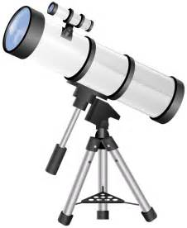

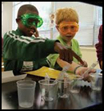
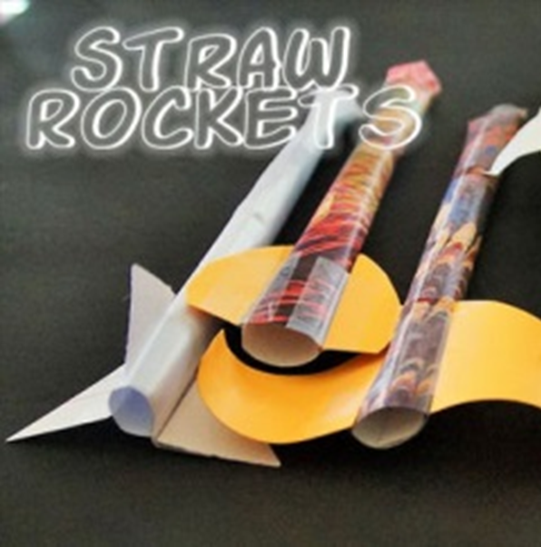
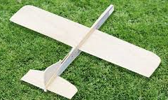
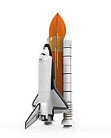
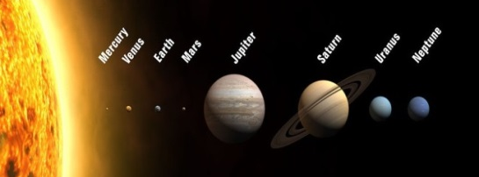

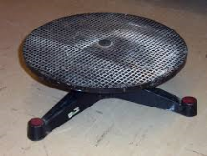
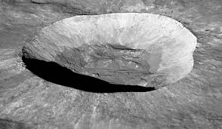

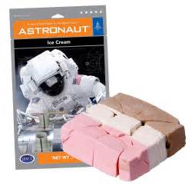
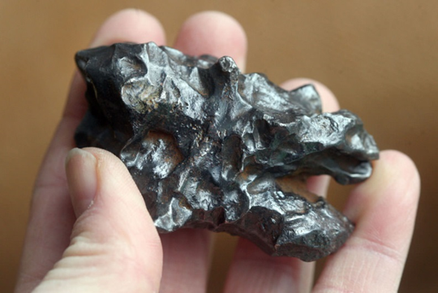

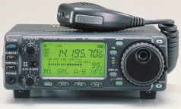
FREE
November 14th, Friday, 6:30-8pm at UNO Durham Science Building
More Info, contact Doug Kaupa,
dkaupa@unomaha.edu
C: 719-433-1304
Observe the stars & planets
Interview astronomers
Enjoy awesome planetarium shows
Aerospace Outreach
Build and fly gliders and straw rockets
Examine Chemistry in Action
Compare planet facts
Discover your weight on other planets & moons
2025
Create lunar craters
Examine meteorites
Rain or Shine
Exchange
Momentum
Launch Pop Rockets
Chat on Amateur Radios
Probe Electricity
Sample Astronaut Ice Cream
FREE

