Slide 1
Seestar s50
What can it do?
How to work it?
By Jeff Goldstein, BBAA VP
Seestar user S50 since December 9, 2023

Slide 2
good and bad (what we can and can’t do)
Pros
Cons
Super Easy to use (once you get used the quirks)
Very Portable and quick to set up
Outreach (great tool for capturing dim targets)
Limited to about magnitude 18 (Pluto is easy)
Now interfaces PC w/ SkySafari 7 and others
Great right “out of the box”
Improvements are made, often monthly
Send photos easily via text, even while shooting
Outstanding location of targets (J2000 to Jnow)
Price $550, (including shipping, carrying case)
Modes: Stargazing, Solar System, and Scenery
Equatorial Mode is easier to set up than Alt/Az
4K photos, self-stacking, and AI Processing
Can text with the developers about any “glitches”
Timelapse movies (great for solar and lunar eclipses)
Remote stargazing in comfort
Slow learning curve and navigating the menus
This is not a “planet killer”
Good, but not a vast database of targets
Limited to about magnitude 18
Limited interface devices (slowly going away)
May need other accessories (battery holder, …)
Sometimes improvement use needs more explanation
.JPGs go directly to your phone directory (com.zwo.Seestar)
Modern Star Atlases use J2000 (conversion was tough)
How long with the plastic gears last? Tripod not practical

Slide 3
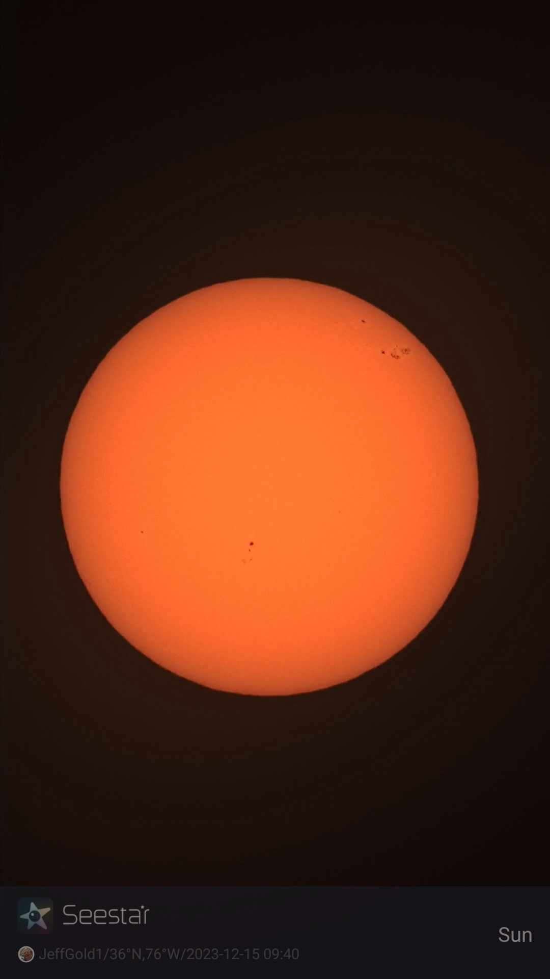
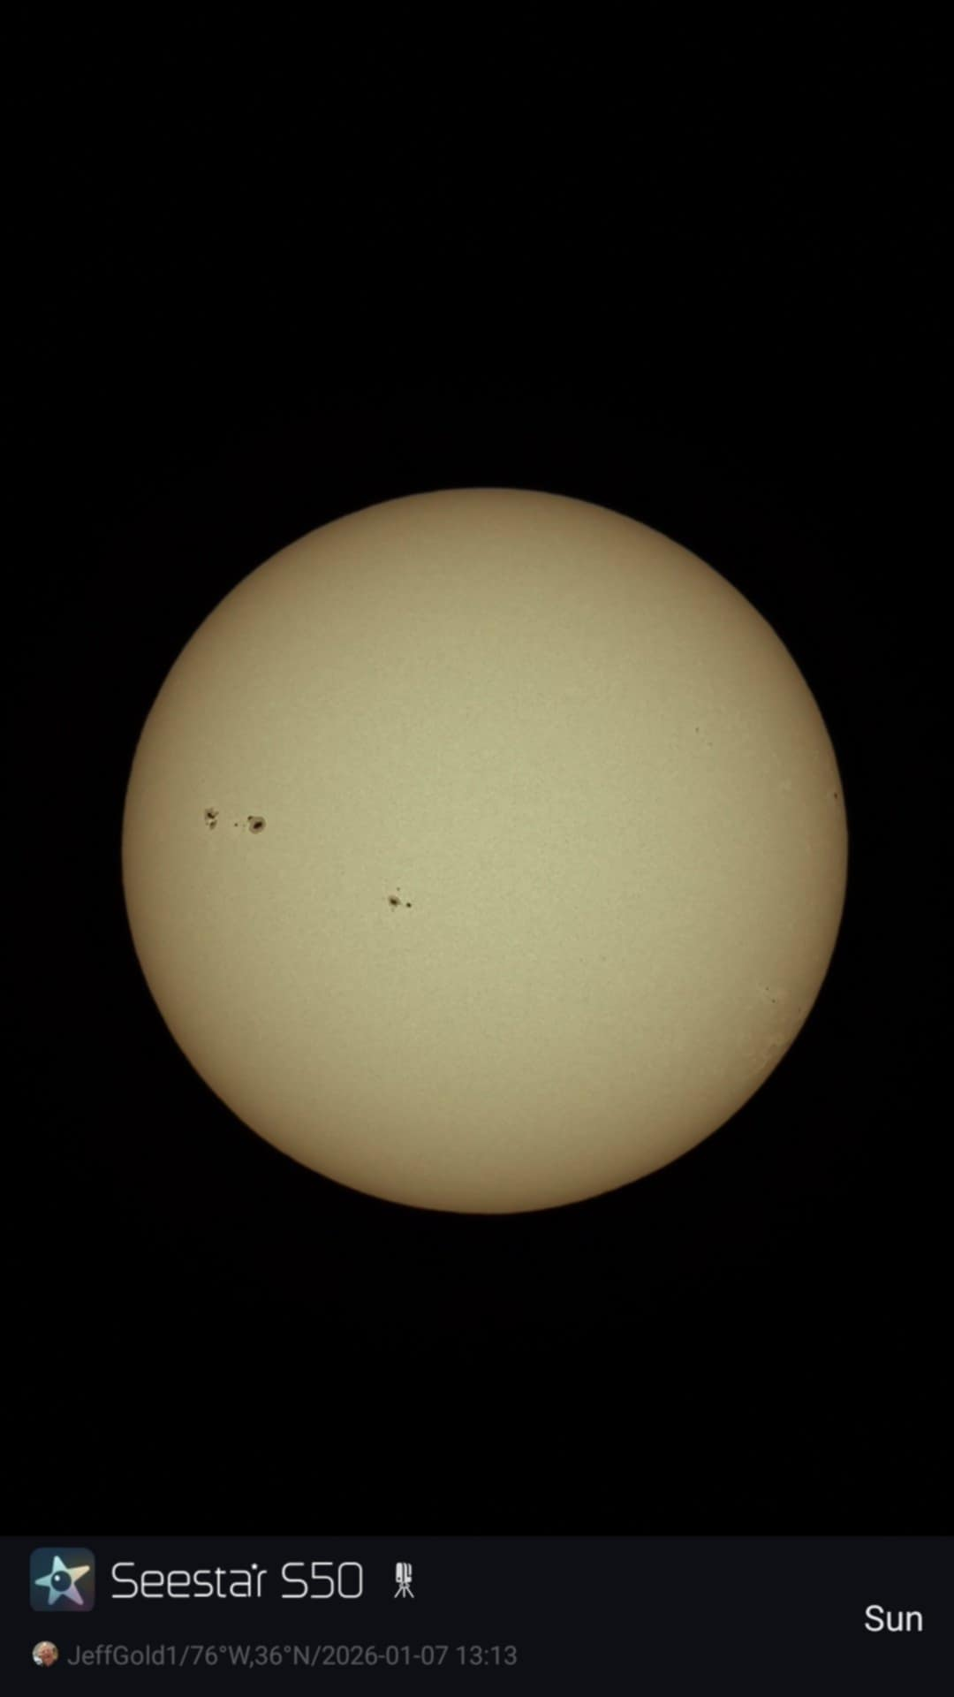
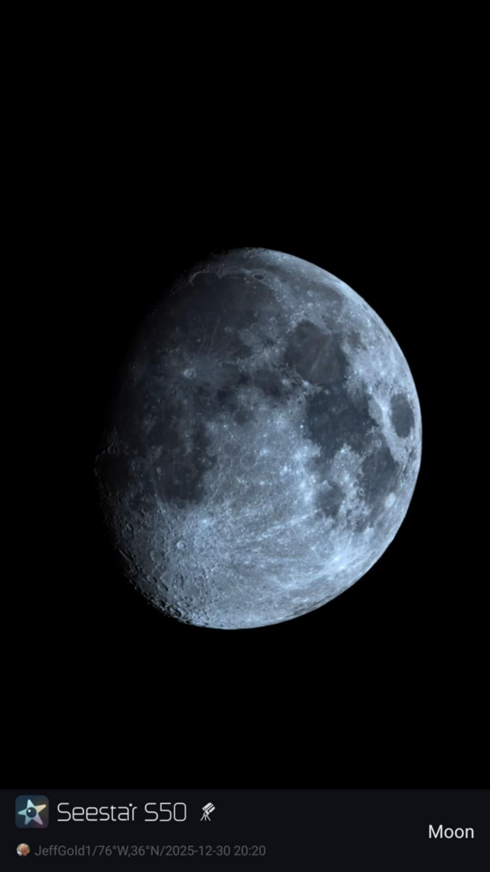
What Can We Do With the Seestar?

Slide 4
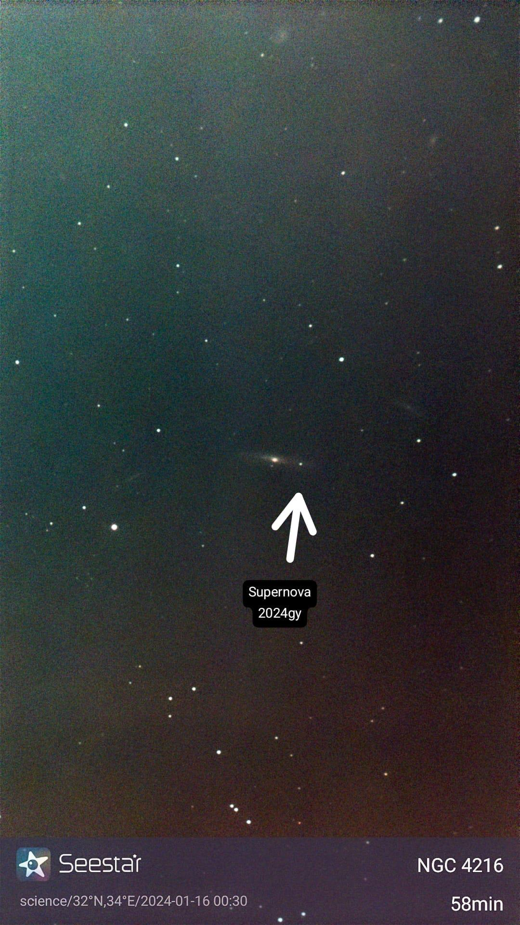
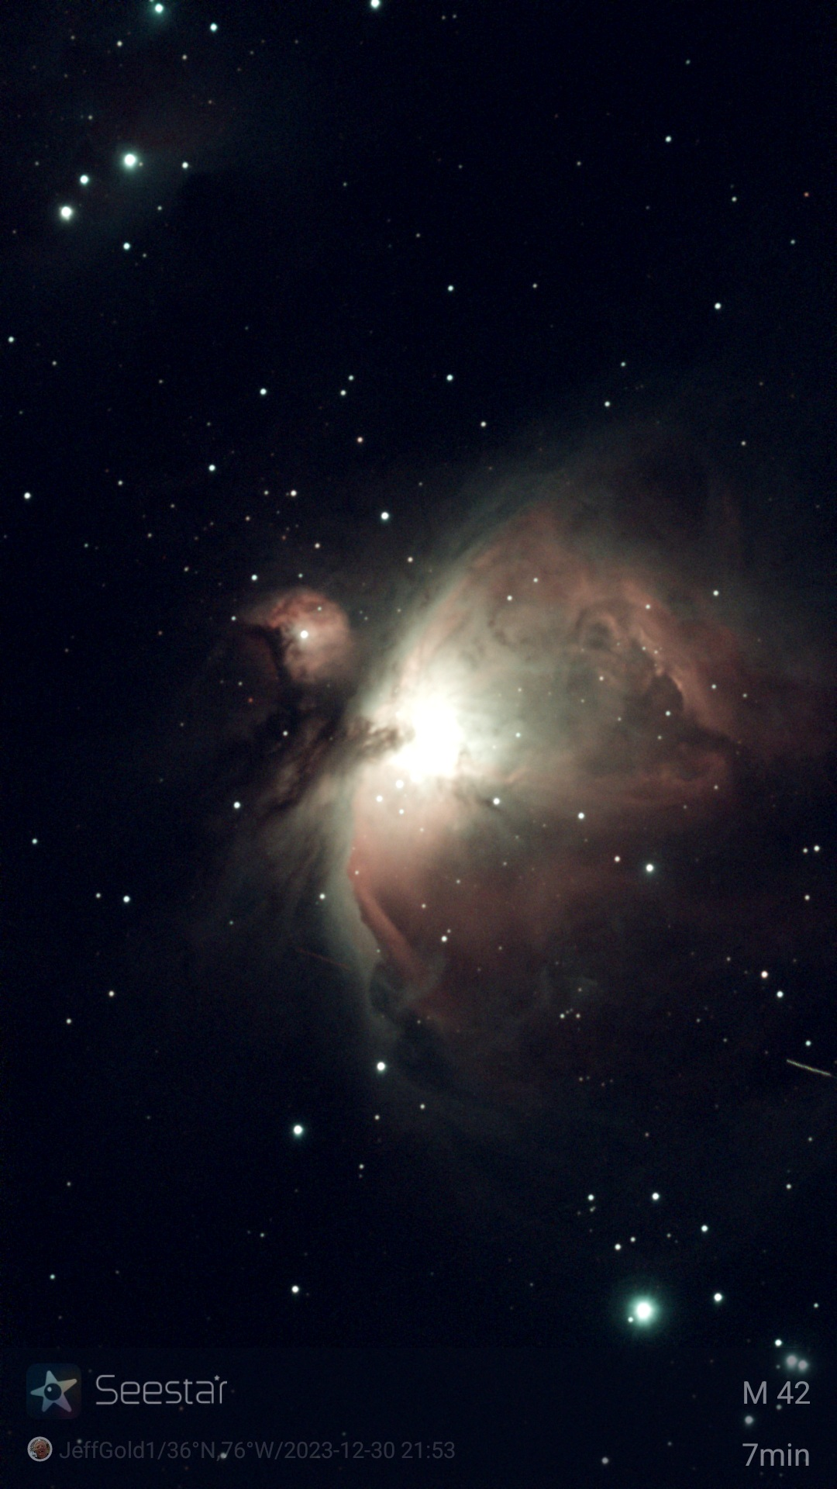
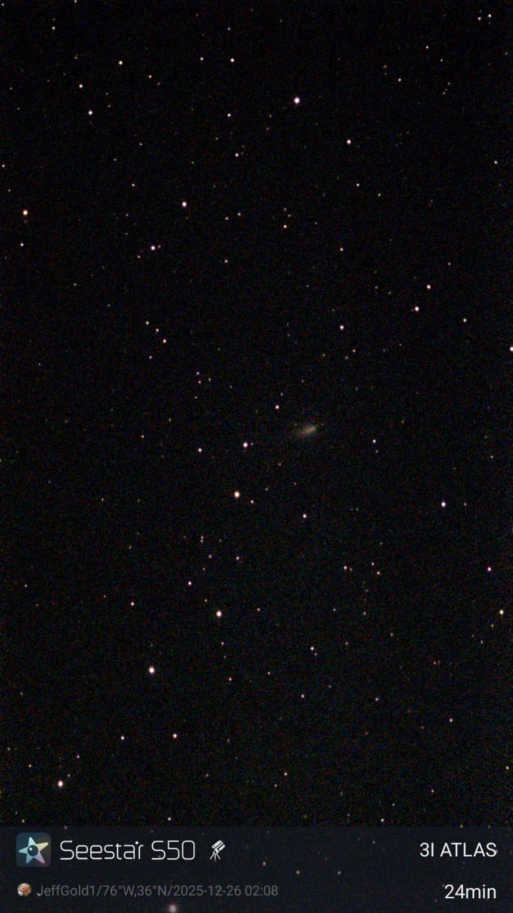
What Can We Do With the Seestar?

Slide 5
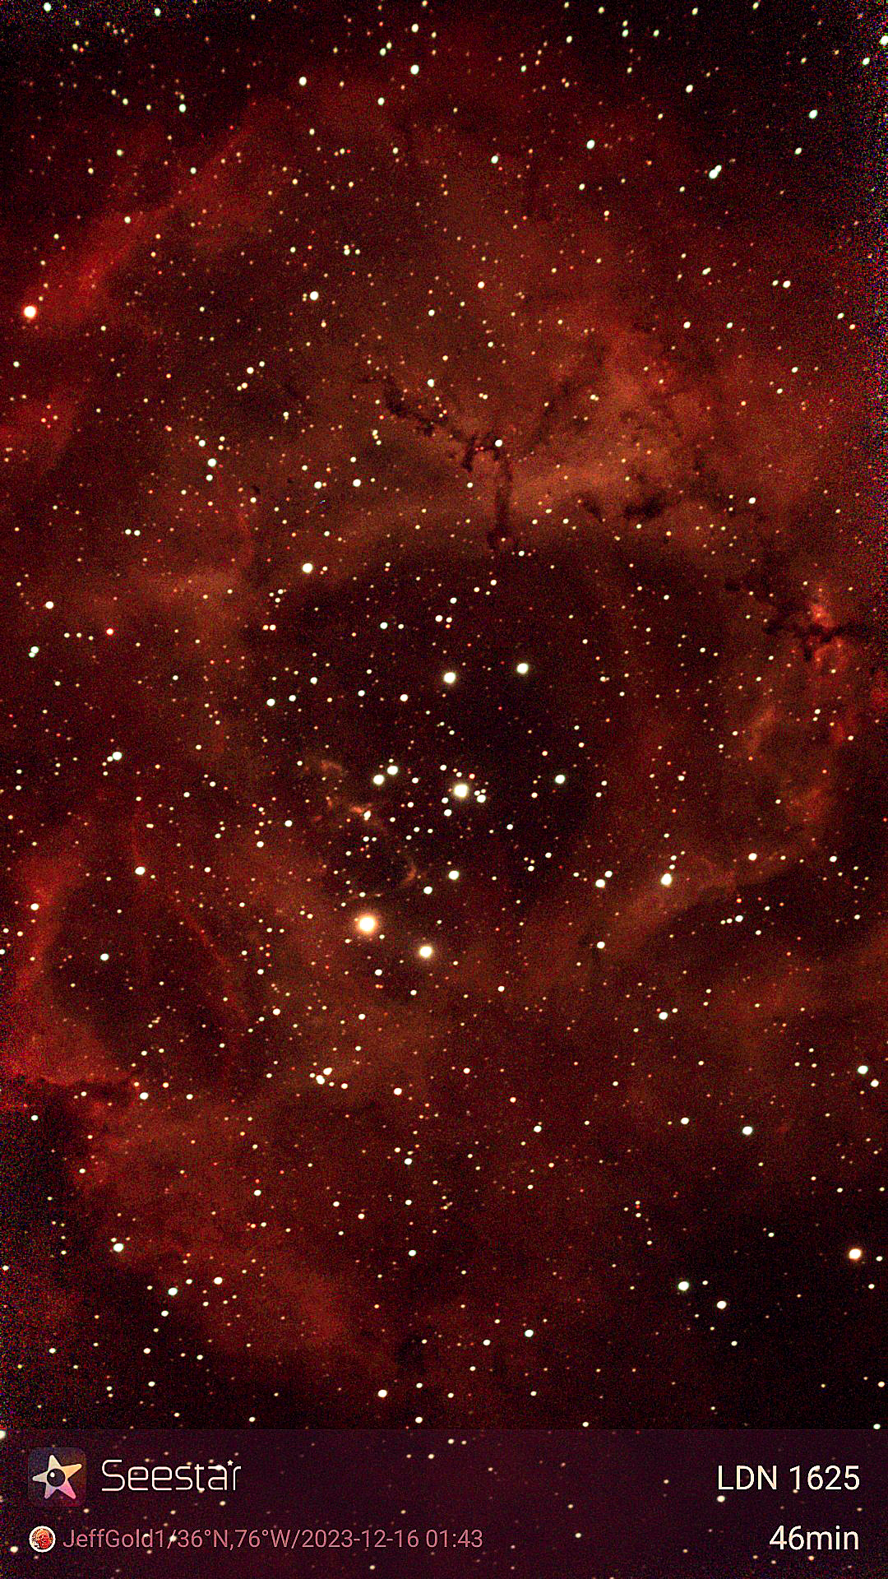

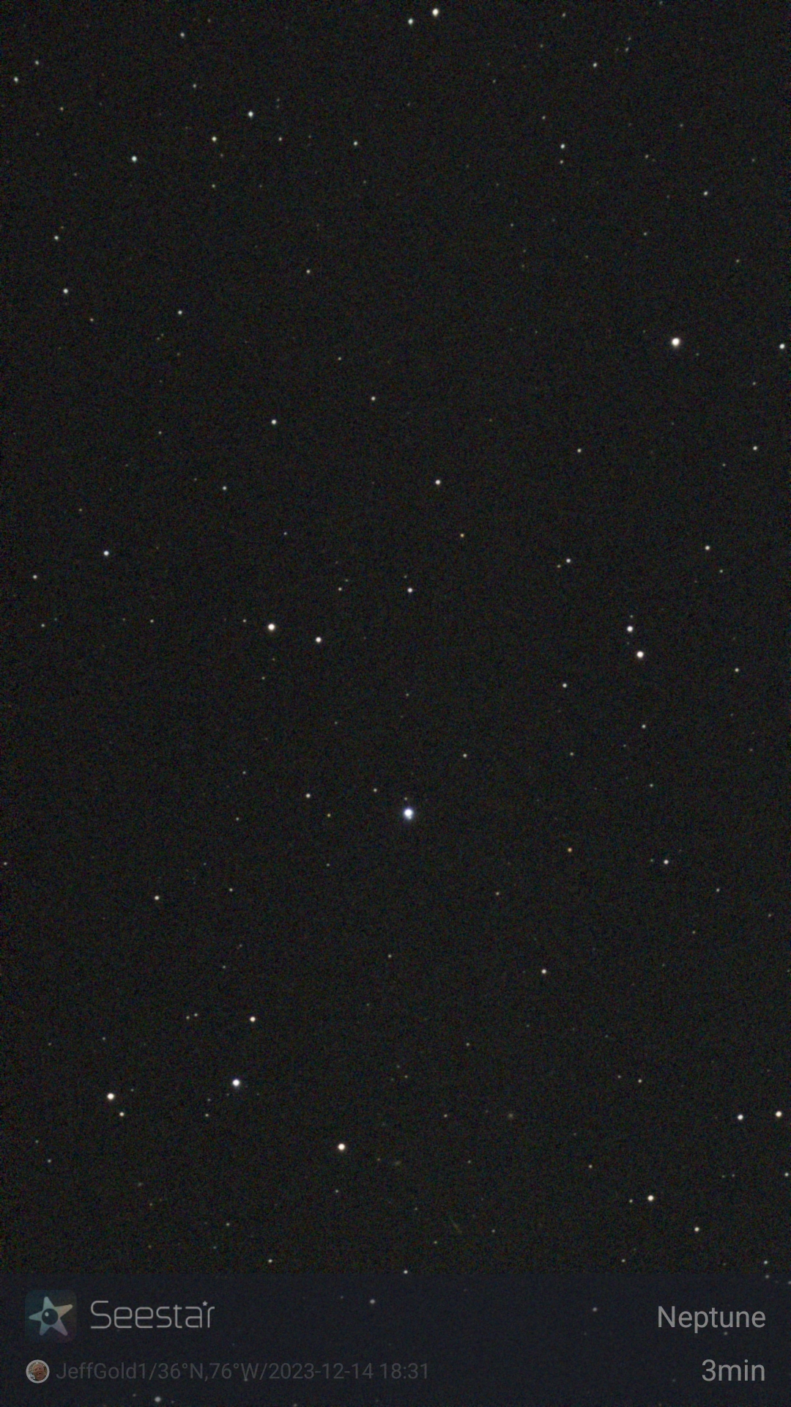
What Can We Do With the Seestar?

Slide 6
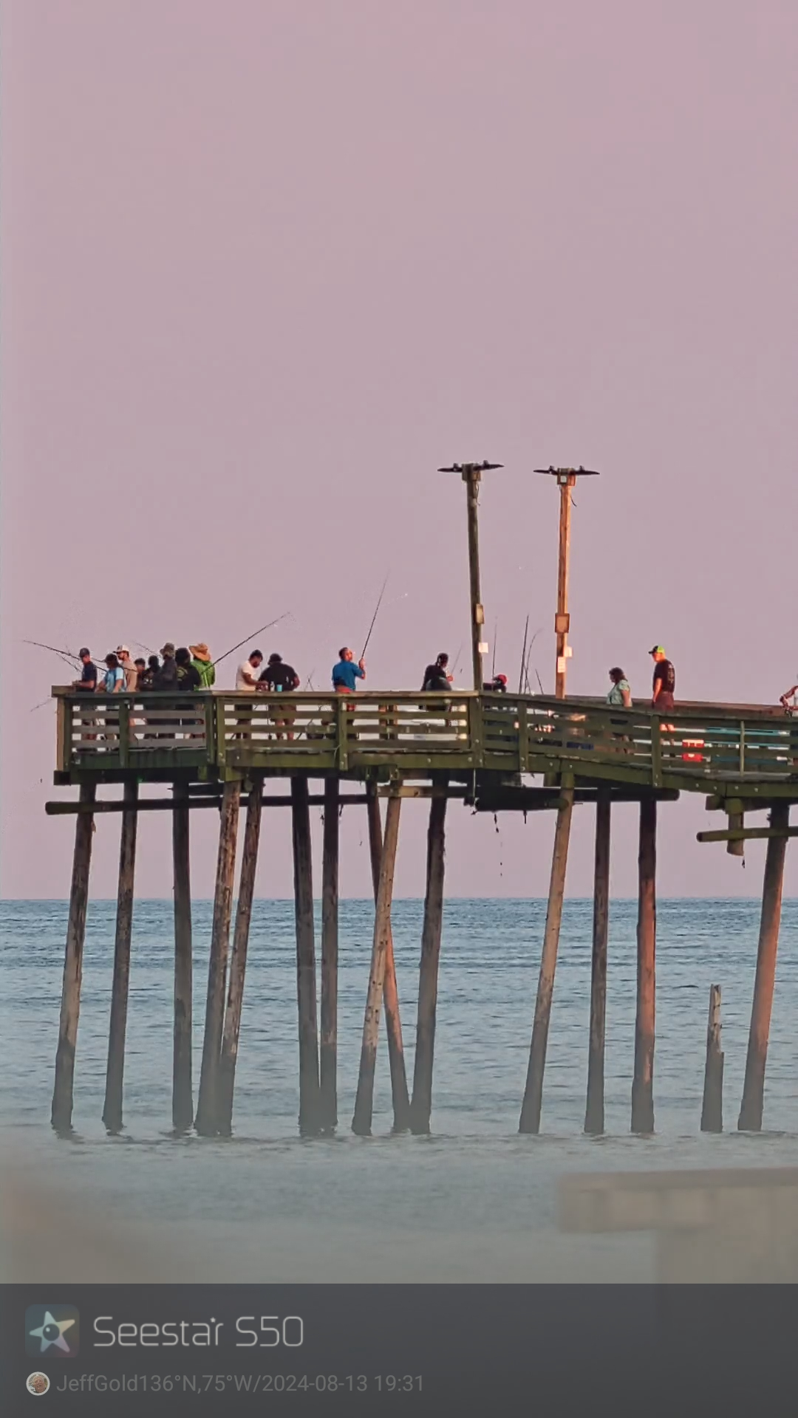
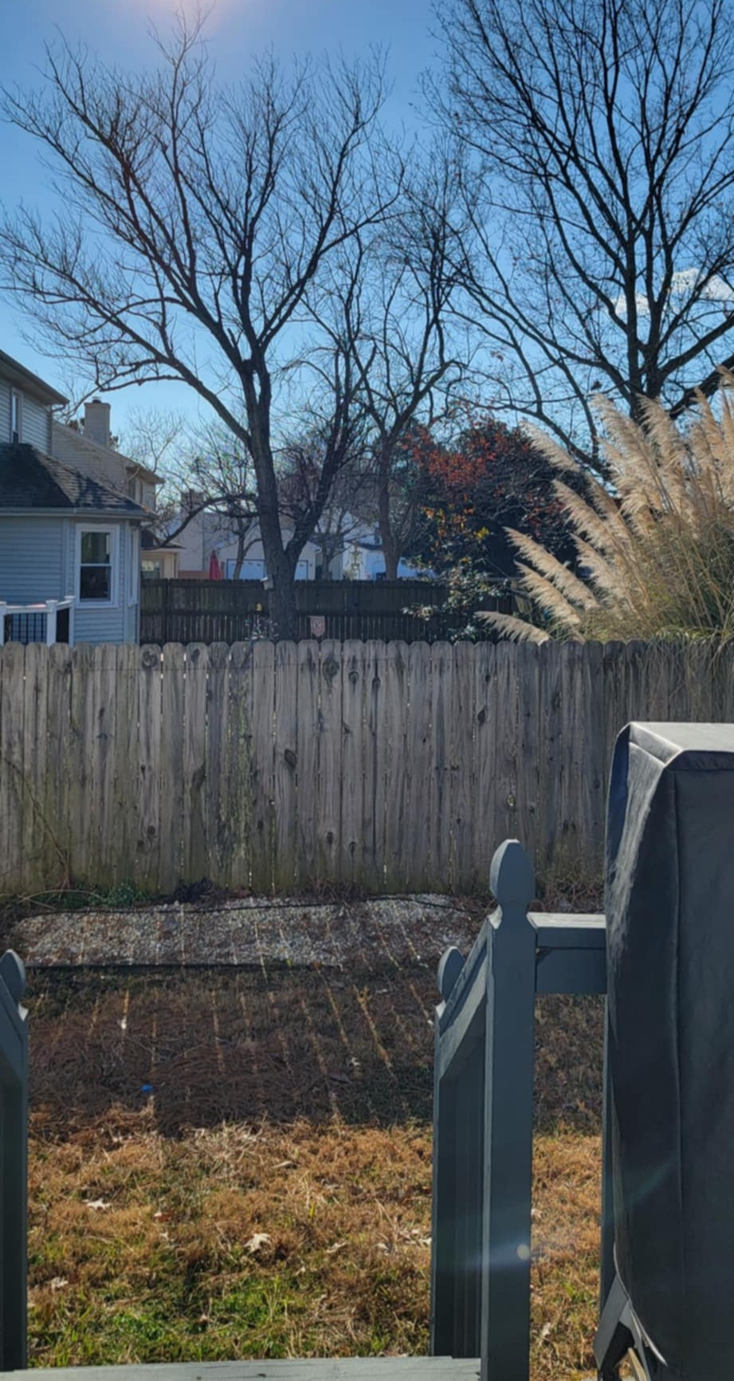

What Can We Do With the Seestar?

Slide 7
Alt/AZ & Eq Setup

Slide 8
Questions/Answers

