Slide 1
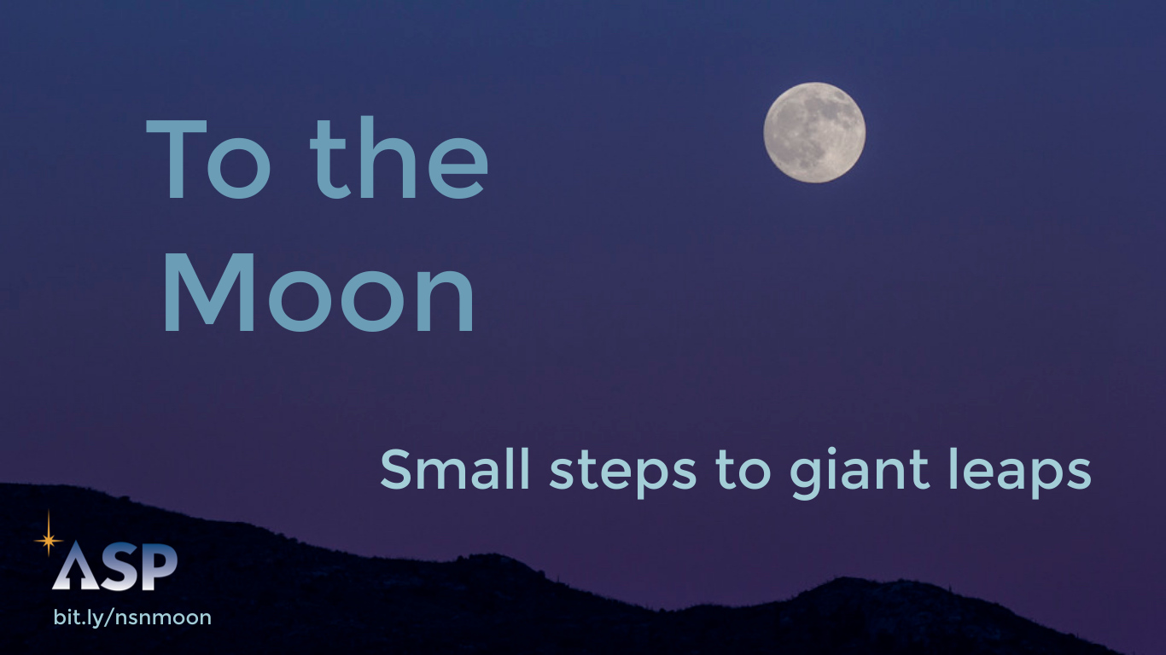
Notes:
Humans have looked up at the Moon in awe since before recorded history. Cultural tales about animals and people going to the Moon via ropes or birds or gods are told in every part of the globe. But 50 years ago we actually sent a human to the Moon. This is our cultural story - our legacy in the quest to touch the Moon.
(optional) Share audio of Moon stories from around the world: http://bit.ly/nsnmoon
----------------
Image credit: Rob Sparks

Slide 2
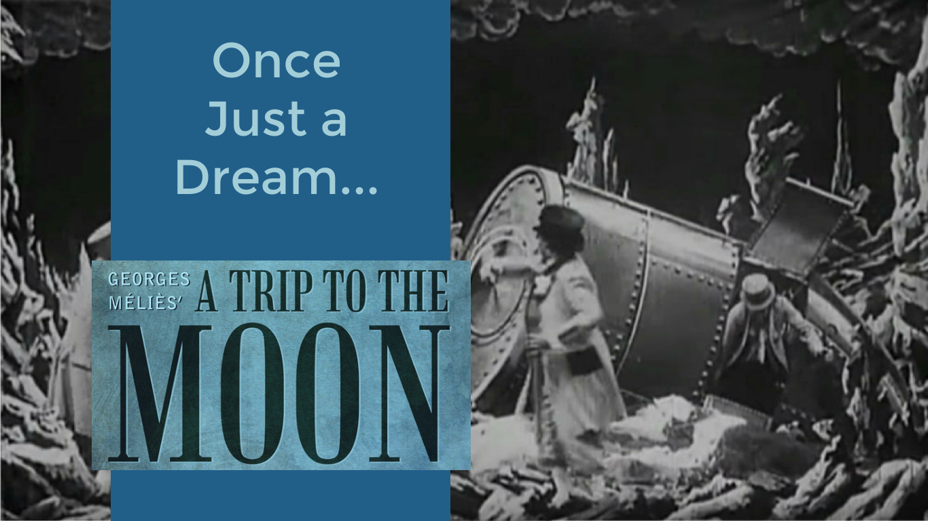
Notes:
Traveling to the Moon was long the stuff of dreams, reserved for Hollywood and science fiction. Many imagined the surface of the Moon to look much like Earth. For example, the dark patches on the Moon were given the name "maria" after being mistaken for seas by early astronomers.
------------
Images from the classic silent movie, “A Trip to the Moon” by Georges Méliès

Slide 3
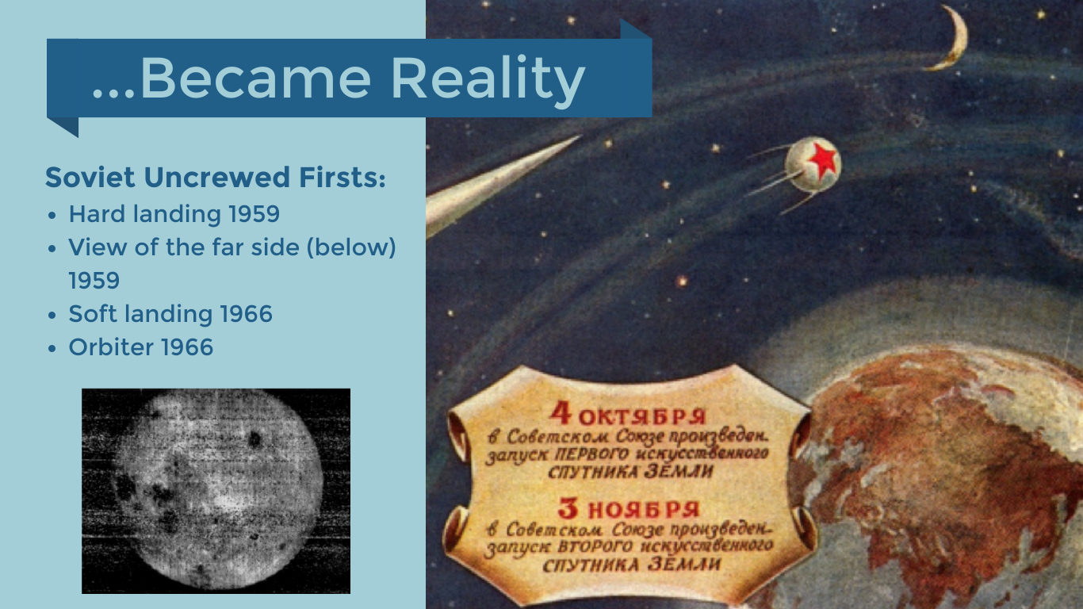
Notes:
Surprising much of the world, the Soviet Union took some of the earliest steps in exploring the Moon close up. We learned a lot.
Luna 2 taught us that the lunar soil was hard enough that we wouldn’t sink
Luna 3 showed us that the far side had many fewer mare and was composed of mostly highlands
Luna 9 sent back the first pictures from the surface
Luna 10 made 460 lunar orbits and sent back 219 data transmissions
------------------
Left photo: Public domain, the first of the far side of the Moon, taken by Luna 3, October 7, 1959
Right photo: Soviet advertisement

Slide 4
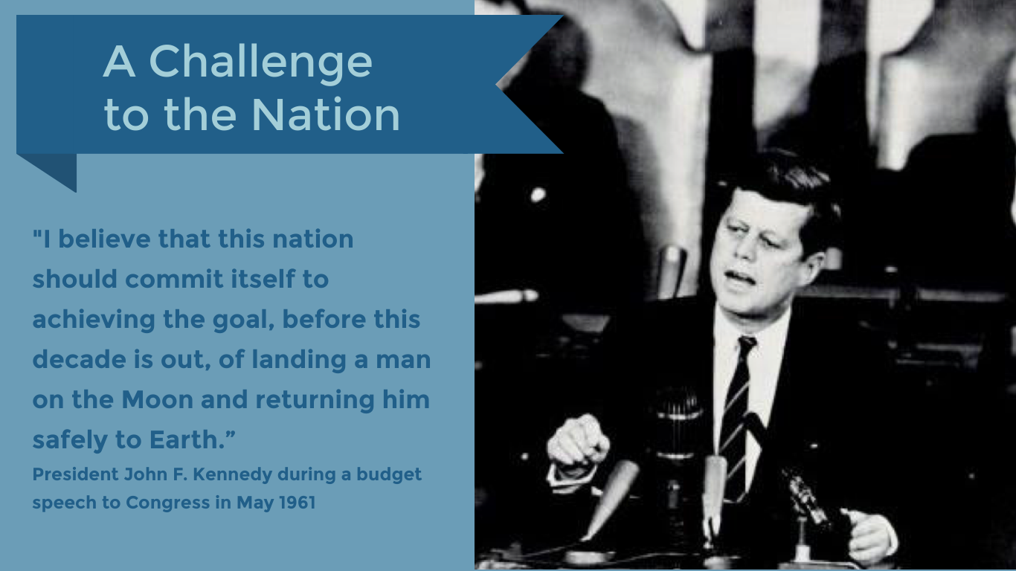
Notes:
Spurred by the surprise launch of the USSR’s Sputnik satellite and further Soviet achievements in space, the United States committed itself to winning the space race. Early in President Kennedy’s tenure, he set forth the challenge for the nation to send people to the Moon.
In his later speech at Rice University in September 1962, President Kennedy eloquently made the case for why we should go to the Moon. By that time, NASA was well on its way in developing the capacity to take humans into space to live, work, and eventually to set foot on our neighboring world.
“We choose to go to the Moon...We choose to go to the Moon in this decade and do the other things, not because they are easy, but because they are hard.” September 12, 1962
------------------
Image credit: NASA

Slide 5
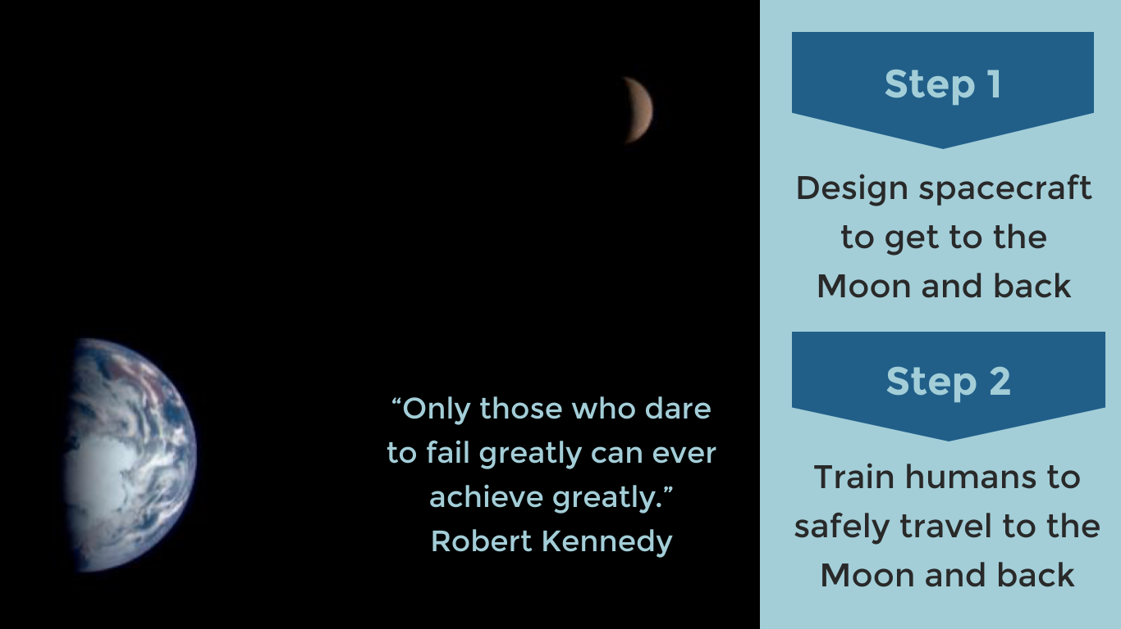
Notes:
Going to the Moon required a two-strand approach to the challenge. The first strand involved solving the challenges of leaving near-Earth orbit, achieving lunar orbit, landing safely, and then lifting off the surface of the Moon.
The other strand involved developing the human-rated spacecraft and techniques for human spaceflight, including technical challenges such as putting a human into orbit, docking two freely-flying spacecraft, and preparing astronauts for piloting these spacecraft. This second strand included the Mercury, Gemini, and early Apollo missions.
There was so much we did not know. But as President Kennedy’s brother, Robert Kennedy said, “Only those who dare to fail greatly can ever achieve greatly.”
-------------------
The image shows the Earth and Moon to scale, as taken from the Galileo spacecraft as it flew by Earth on its way to orbit Jupiter.
Image credit: NASA

Slide 6
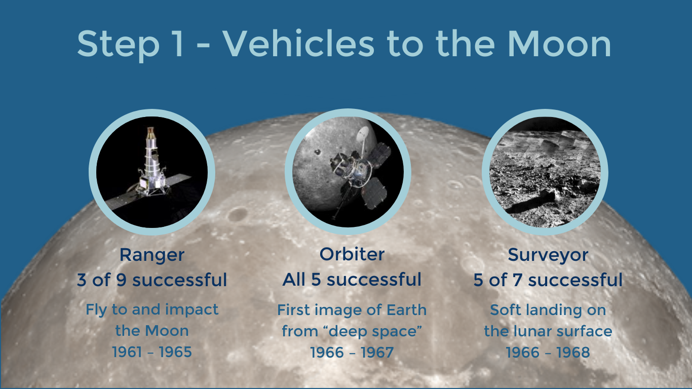
Notes:
In the early 1960s, it was difficult to reliably launch anything into Earth orbit, let alone send a spacecraft to the Moon. The Ranger, Lunar Orbiter, and Surveyor programs of lunar exploration were designed to address this problem using uncrewed spacecraft. As these missions were at the absolute leading edge of rocket science, their individual missions were not always successful, but valuable information was gleaned even from failures.
1) The Ranger program was developed to design, and send a spacecraft to the Moon. The primary goal was to reach the Moon, and the 3 successful missions crashed, as intended, into the lunar surface.
2) But landing a human – safely – on the Moon obviously had to be more advanced than just crash landing. The Lunar Orbiter missions were developed to put a spacecraft into lunar orbit, and from that vantage point, to begin the systematic mapping of the Moon’s surface.
3) Having learned how to send a spacecraft into lunar orbit, the next step was to try a soft landing on the Moon’s surface, where a spacecraft could do on-surface imaging and rudimentary science. The Surveyor program successfully demonstrated how to make these soft landings. Incredibly, the Apollo 12 lunar module landed close to Surveyor 3, with astronauts visiting the older spacecraft and returning its camera to the Earth.
--------------
All images credit: NASA

Slide 7
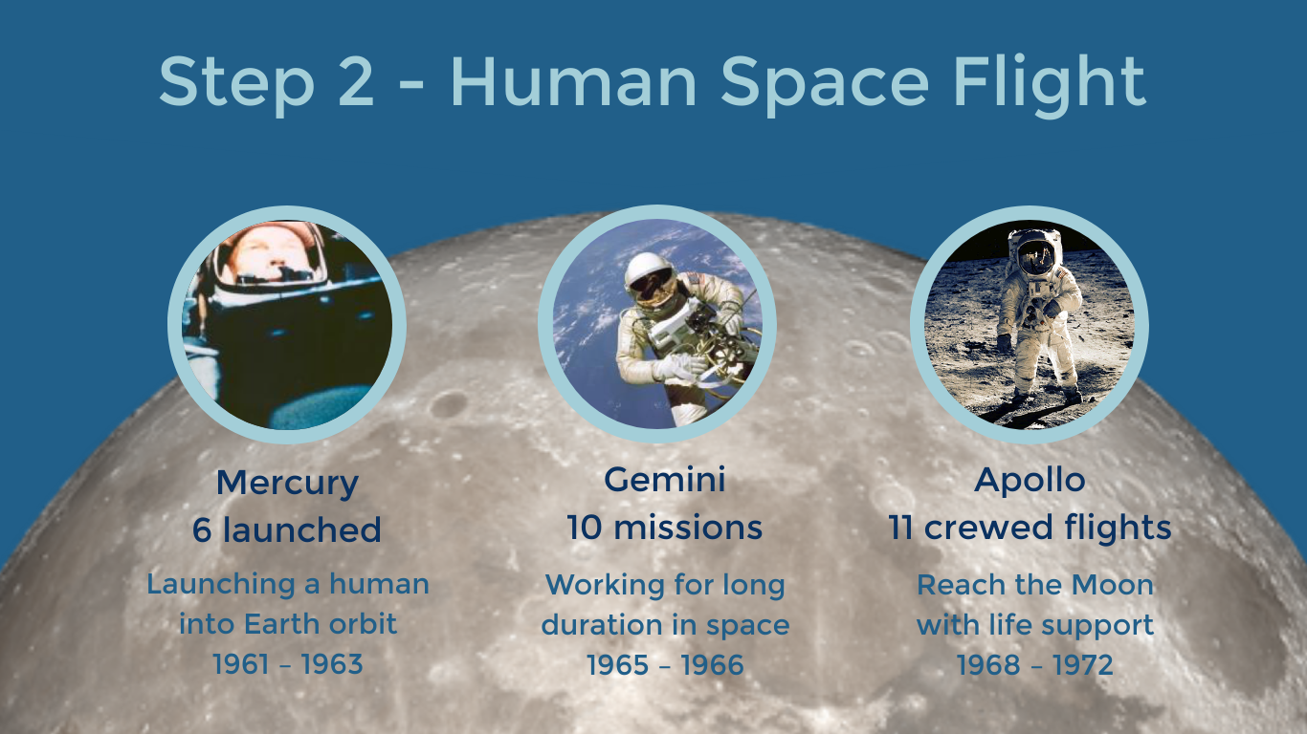
Notes:
The second challenge was to developing the spacecraft and techniques to allow humans to live and work in space on a prolonged voyage to the Moon and back. The first of these programs, Mercury, was designed to develop the spacecraft and human capacity for achieving Earth orbit. Following two sub-orbital flights, four spacecraft achieved Earth orbit, with John Glenn being the first US citizen to orbit the Earth inside the Friendship 7 capsule.
Going to the Moon requires more than just lifting off the Earth and pointing the spacecraft in the right direction. Landing on the Moon would require a second module to separate while in lunar orbit, descend and land on the surface, and then then blast back off to rejoin the orbiting module. Then, after all that, the spacecraft would then need leave lunar orbit to return to the Earth. The Gemini program involved two astronauts aboard a larger spacecraft. The Gemini program featured the first spacewalk for an American astronaut, flying in formation with a second capsule, and testing docking procedures to allow for movement between two conjoined spacecraft. All ten Gemini missions were successful.
The Apollo program was charged with producing a spacecraft with the capability of supporting a crew of three on a journey to the Moon and back. Apollo had six successful lunar landings (Apollos 11, 12, 14, 15, 16, and 17), two that achieved lunar orbit (Apollo 8 and 10), and one that had to return to Earth after an explosion in the service module crippled the spacecraft (Apollo 13). Apollo 7 was the initial test flight with humans aboard into Earth orbit, and Apollo 10 was a test flight to the Moon with the lunar module performing a test run towards, but not landing on, the lunar surface.
All images credit: NASA

Slide 8
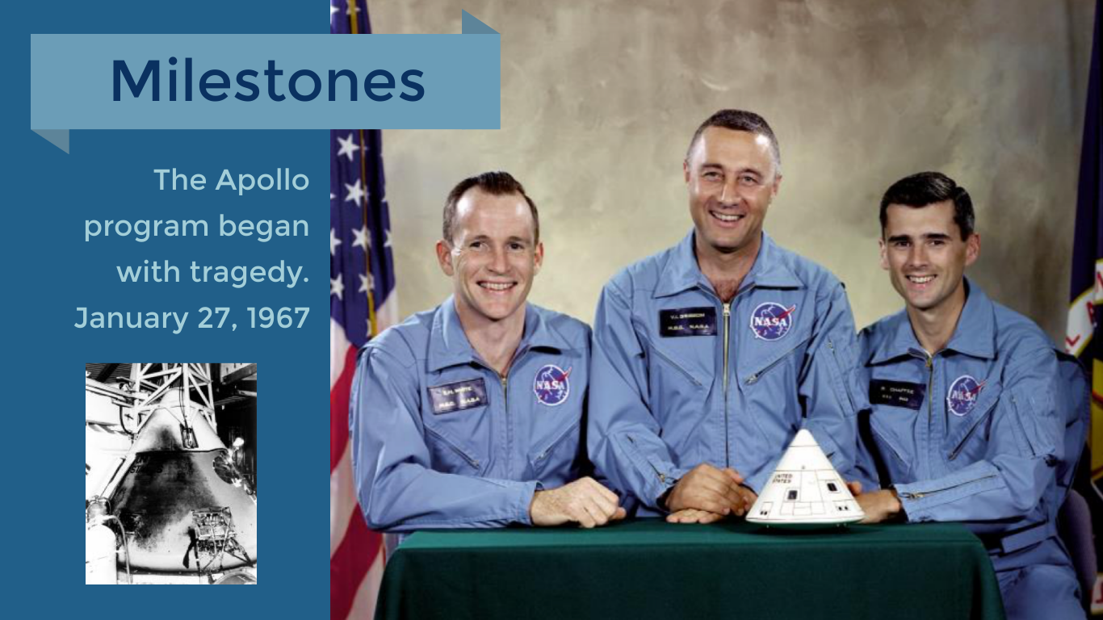
Notes:
The Apollo timeline experienced a tragic setback on January 27, 1967, as a catastrophic fire broke out in the crew compartment of the Apollo 1 capsule during a pre-flight test on the launch pad, resulting in the deaths of all three astronauts who were trapped inside. Gus Grissom, Ed White, and Roger Chaffee are now honored on the NASA Day of Remembrance every January 31, along with the astronauts who lost their lives on the Challenger and Columbia space shuttles.
-------------------
Image credits: NASA
Notes: This fire resulted in a several big changes in policy, most notably a ban on using a pure oxygen environment inside a spacecraft, as was the case in Apollo 1.
This crew was posthumously called “Apollo 1.”

Slide 9
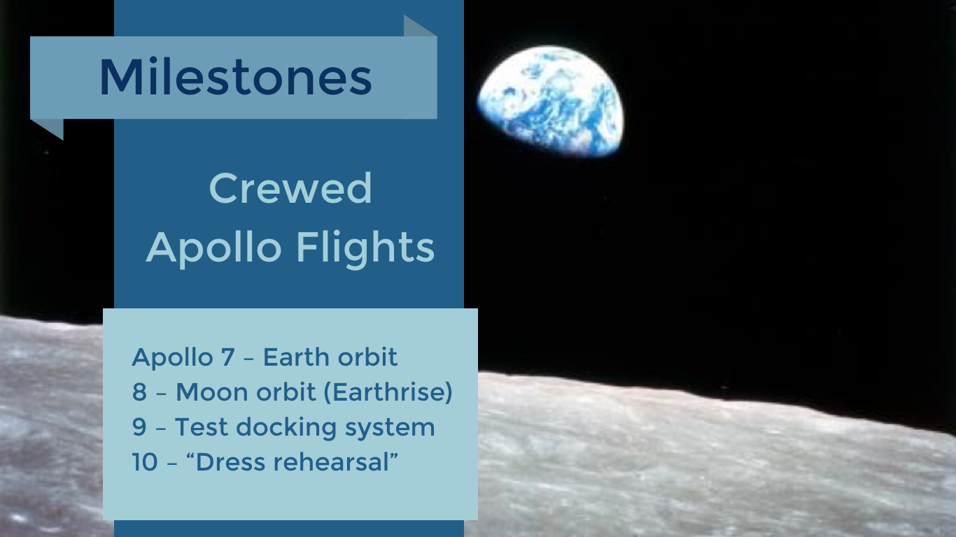
Notes:
The Apollo 1 fire introduced a delay into the mission timeline as NASA redesigned the safety features of the crew compartment. With modifications complete, and after two un-crewed test flights, Apollo 7 launched into Earth orbit on October 11, 1968.
Just two months later, on December 21, 1968, Apollo 8 launched the first human-crewed flight to the Moon.
The next two Apollo missions prepared NASA for putting all of the pieces together.
-------------------
The image shows the iconic Earthrise, taken by Bill Anders from Apollo 8 as it orbited the Moon.
Image credit: NASA
(Optional) A visualization of this can be found here: https://youtu.be/dE-vOscpiNc
This video is public domain and can be downloaded at: http://svs.gsfc.nasa.gov/goto?4129

Slide 10
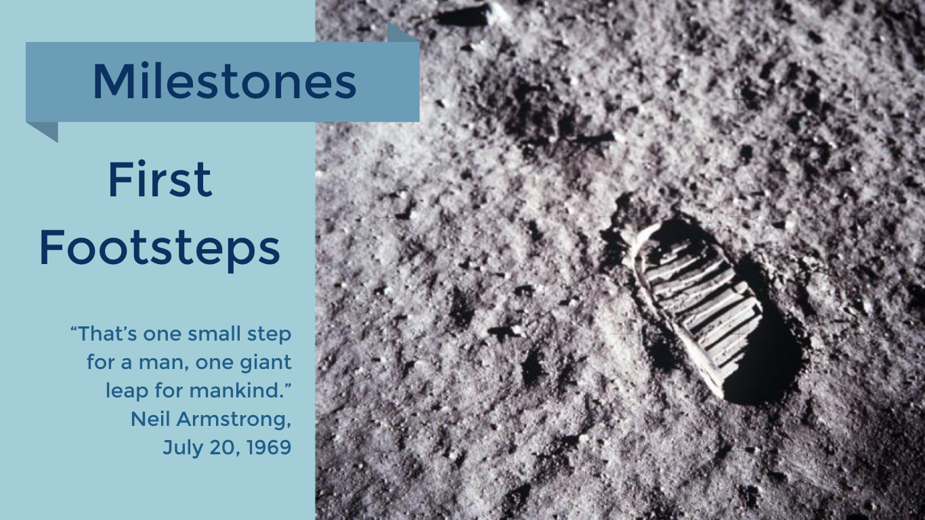
Notes:
Less than a year after the first Apollo Earth orbit, Apollo 11 blasted off to the Moon on July 16, 1969. Early on July 20, 1969, the lunar module landed at Tranquility Base, with Neil Armstrong and Buzz Aldrin emerging a short while later for humanity’s first moonwalk.
“That’s one small step for a man, one giant leap for mankind” - Neil Armstrong
Apollo 12 also saw a successful Moon landing.
-------------------
Image credit: NASA

Slide 11
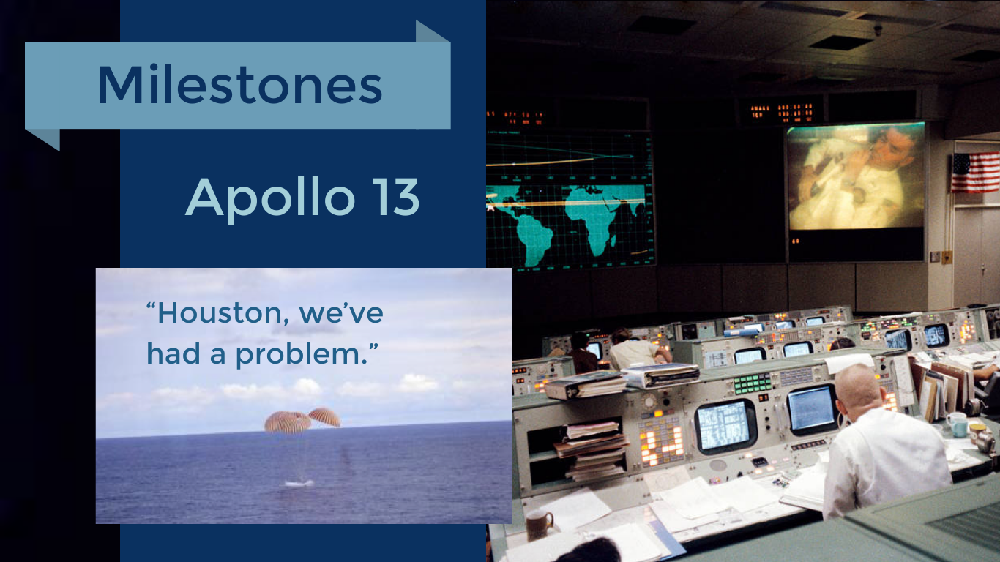
Notes:
Every journey includes some stumbles, particularly when the vehicle taking you on the journey is one of the most complex machines ever built. Two days after launch, on April 13, 1970, well on the way to the Moon, an explosion in an oxygen tank in the Apollo 13 service module crippled the spacecraft. After much debate and investigation, it was determined the safest course of action was a to use the Moon's gravity to send the spacecraft on a return trajectory. The plan succeeded, and the three astronauts returned safely to Earth on April 17.
-------------------
Image credit: NASA
This photograph of the Mission Operations Control Room in the Mission Control Center at the Manned Spacecraft Center (now Johnson Space Center), Houston, was taken on April 13, 1970, during the fourth television transmission from the Apollo 13 mission. Eugene F. Kranz (foreground, back to camera), one of four Apollo 13 flight directors, views the large screen at front as astronaut Fred W. Haise Jr., Lunar Module pilot, is seen on the screen.

Slide 12
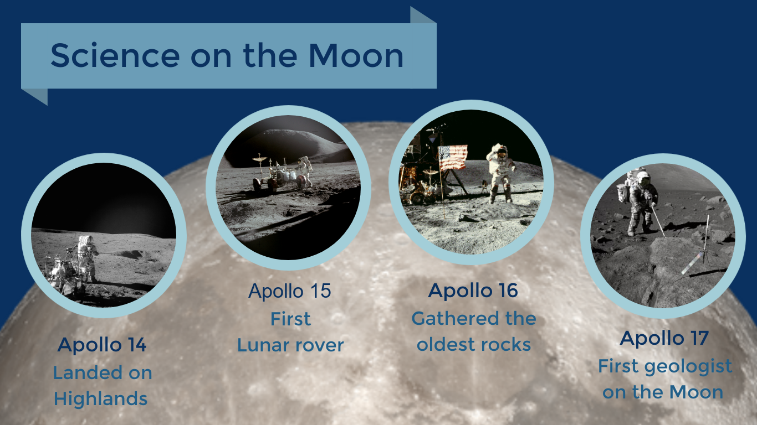
Notes:
Following the near tragedy of Apollo 13, the next lunar mission (Apollo 14) launched on January 31, 1971. The final four Apollo lunar landings produced a great deal of science and demonstrated technical innovations such as the Lunar Roving Vehicle, used on Apollo missions 15, 16, and 17. Apollo 17 also featured the first scientist-astronaut, as geologist Harrison Schmitt explored the Moon.
All told, the six lunar landings returned 382 kg (842 lb) of rock and soil for study in laboratories around the nation and world.
In a span of 42 months, twelve humans set foot on the Moon. Twelve others remained either in orbit, or flew by, such as Apollo 13, and safely returned to Earth. On December 15, 1972, three astronauts left the near-Moon environment to return to Earth. Since then, no one has returned…yet.
----------------------
All images credit: NASA

Slide 13
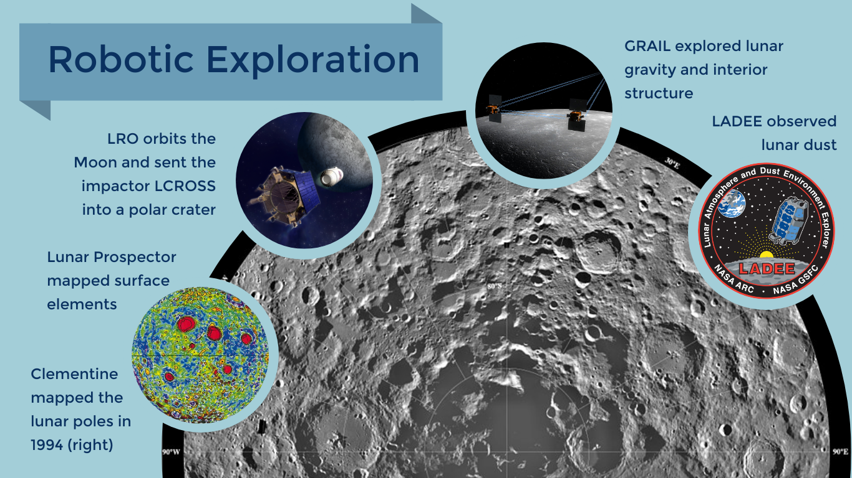
Notes:
The direction of NASA's programing changed, and following Apollo, robotic missions were instead sent beyond the Moon to distant planets.
Starting again in the 1990s, NASA embarked on an ambitious program of robotic lunar exploration.
These missions had many objectives, and taught us much about our nearest neighbor as well as our home planet. A few of them are listed here.
------------------------
All images credit: NASA
More info, from https://moon.nasa.gov/
1994 - Clementine provided our first complete look at the lunar surface, including the poles. And it found evidence suggesting that a crater at the south pole, with a floor that is permanently shielded from the Sun, harbors water ice.
1998 - Lunar Prospector's data showed an estimated six billion tons of water ice trapped in the shadows of the lunar polar regions. The spacecraft also detected strong localized magnetic fields; mapped the global distribution of major rock types; and discovered signs of a tiny, iron-rich core.
2009 - One of Lunar Reconnaissance Orbiter’s (LRO) first surprising discoveries was the super-cold temperatures in the permanently shadowed craters of the Moon's south polar region. The temperatures -- -397 degrees Fahrenheit (-238 degrees Celsius) -- are among the coldest surface temperatures measured in the solar system, colder even than Pluto.
Launched with LRO, LCROSS launched into a permanently dark floor of a polar crater. The missions found evidence that the lunar soil within shadowy craters is rich in useful materials, and the moon is chemically active and has a water cycle. Scientists also confirmed the water was in the form of mostly pure ice crystals in some places.
2011 - The twin GRAIL probes orbiting Earth's moon generated the highest resolution gravity field map of any celestial body. The gravity field map revealed an abundance of features never before seen in detail, such as tectonic structures, volcanic landforms, basin rings, crater central peaks and numerous simple, bowl-shaped craters.
2013 – LADEE studies the Moon’s exosphere—an atmosphere that is so thin that its molecules do not collide with each other — LADEE’s instruments helped further the study of other planetary bodies with exospheres such as Mercury and some of Jupiter’s moons.

Slide 14
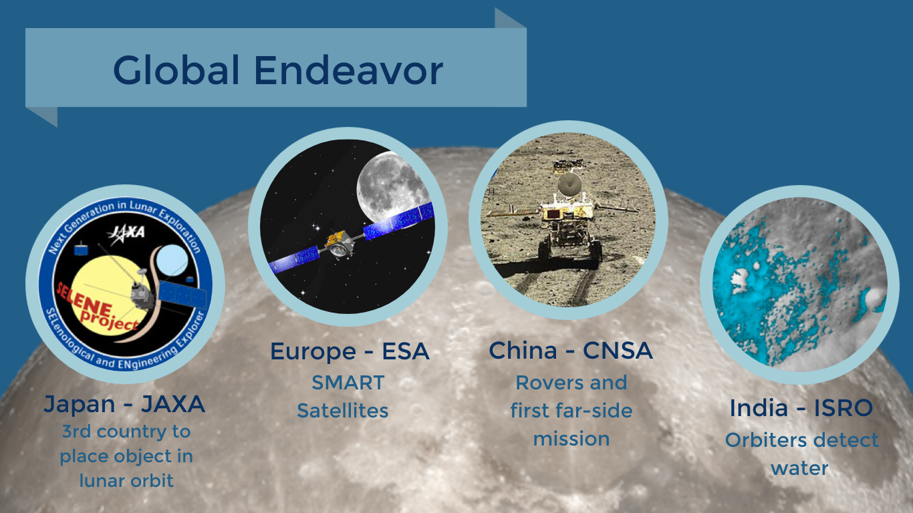
Notes:
Space agencies around the world have now entered the Lunar playing field.
Japan became the 3rd country to place an object in orbit around the moon in 1990
China and India made the 3rd and 4th soft landing on the Moon, with China deploying the first far-side lander and rover – Chang’e 4
As of June 2019, no successful lunar landings have been completed by commercial enterprises, though there are active competitions happening, such as the Lunar XPRIZE.
--------------------
Image credit L-R:
Japan Aerospace Exploration Agency (JAXA) - Logo for SELENE orbiter, launched in 2007
European Space Agency (ESA) - Artist conception of a SMART mission - 'Small Missions for Advanced Research in Technology’ - SMART 1 launched in 2003
China National Space Administration (CNSA) - Yutu, China’s first Moon rover taken by Chang’e 3
NASA and Indian Space Research Organisation (ISRO) – showing water abundance in a lunar crater

Slide 15

Notes:
These steps are only the beginning of a continuing journey. NASA is currently developing the hardware to take humans back to the Moon, with the goal to establish a permanent presence on the surface as well as in an orbiting space station. A human presence on the Moon will serve as a jumping off point for missions further out into the solar system. Someone who is alive today may well be the first to set foot on Mars.
---------------------------
Illustration credit: NASA
From https://moon.nasa.gov: “The goals of lunar return this time are not to prove that we can do it (as Apollo did) but to learn how to use the moon to support a new and growing spacefaring capability. On the moon, we will learn the skills and develop the technologies needed to live and work on another world. We will use this knowledge and technology to open the solar system for human exploration.”

