Slide 1
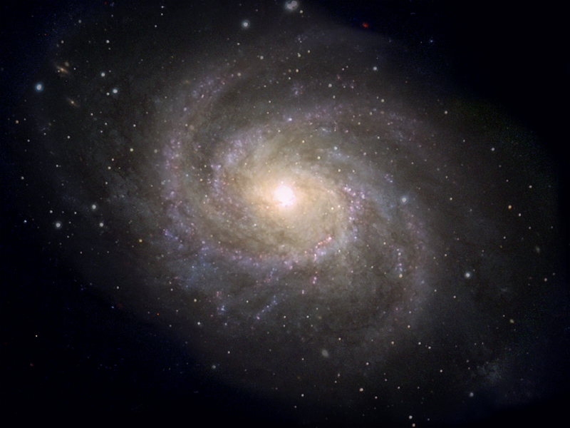
Our Place in Our Galaxy
Notes:
Use the script from the manual as a guide for this PowerPoint.
Image is a artist’s conception of the Milky Way Galaxy: artist is employed by the Space Telescope Science Institute (Hubble).

Slide 2
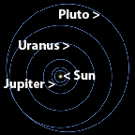
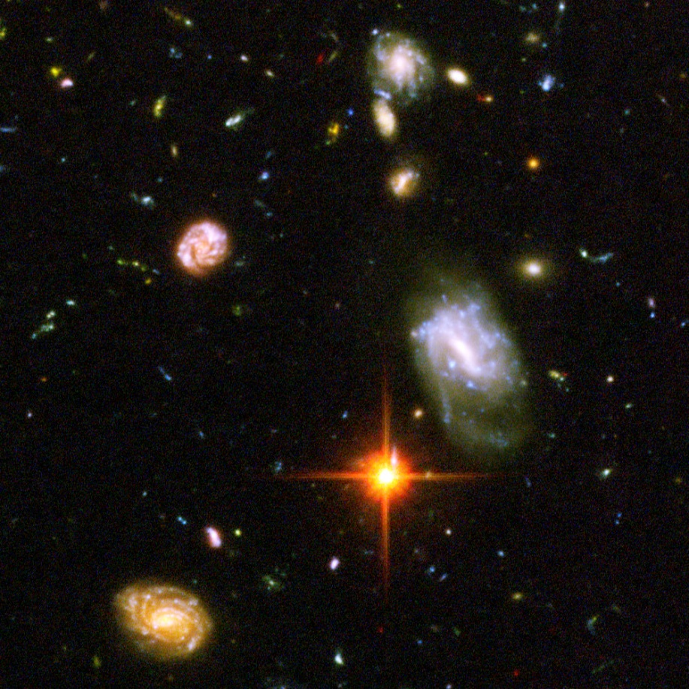

What’s the Difference?
Solar System
Universe
Galaxy
Image credits: NASA, STScI

Slide 3
What’s the Difference?
Solar System
Universe
Galaxy

Slide 4
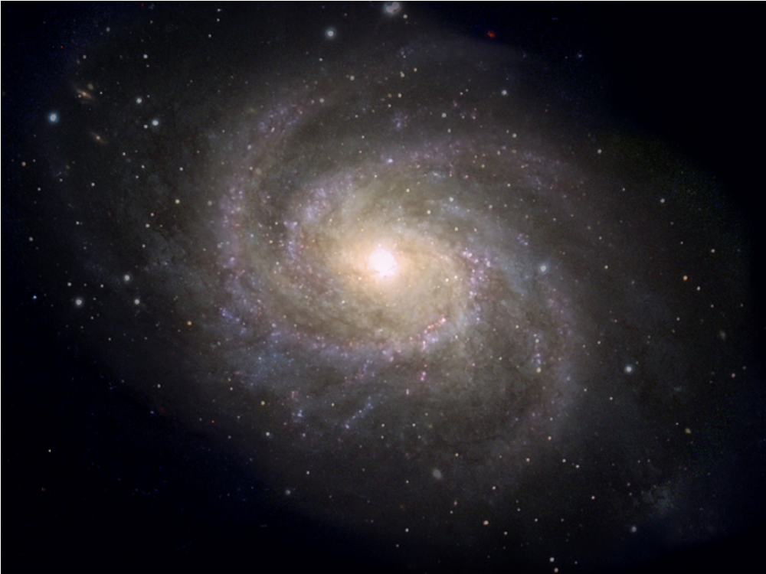
Where is our Solar System?
Solar
System
here
Visible stars, gas, dust in the Milky Way Galaxy
Image credits: NASA, STScI

Slide 5
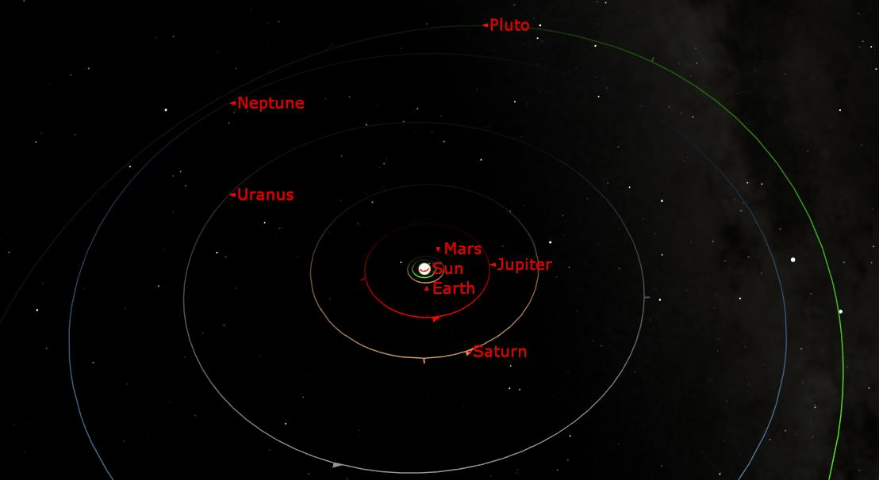
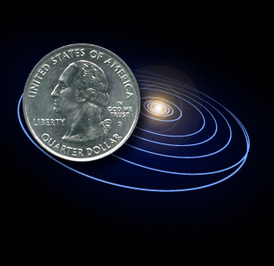
Solar System

Slide 6
How big is the Milky Way Galaxy?
100,000 light years
Image credits: NASA, STScI

Slide 7
How far is 100,000 light years?
1 inch represents 5.5 light hours (Sun to Pluto)
1 mile represents 40 light years
2,500 miles
represents
100,000 light years
Notes:
On this scale, our Sun would be much smaller than a grain of sand.
What do you know about that is about 2,500 miles across?

Slide 8
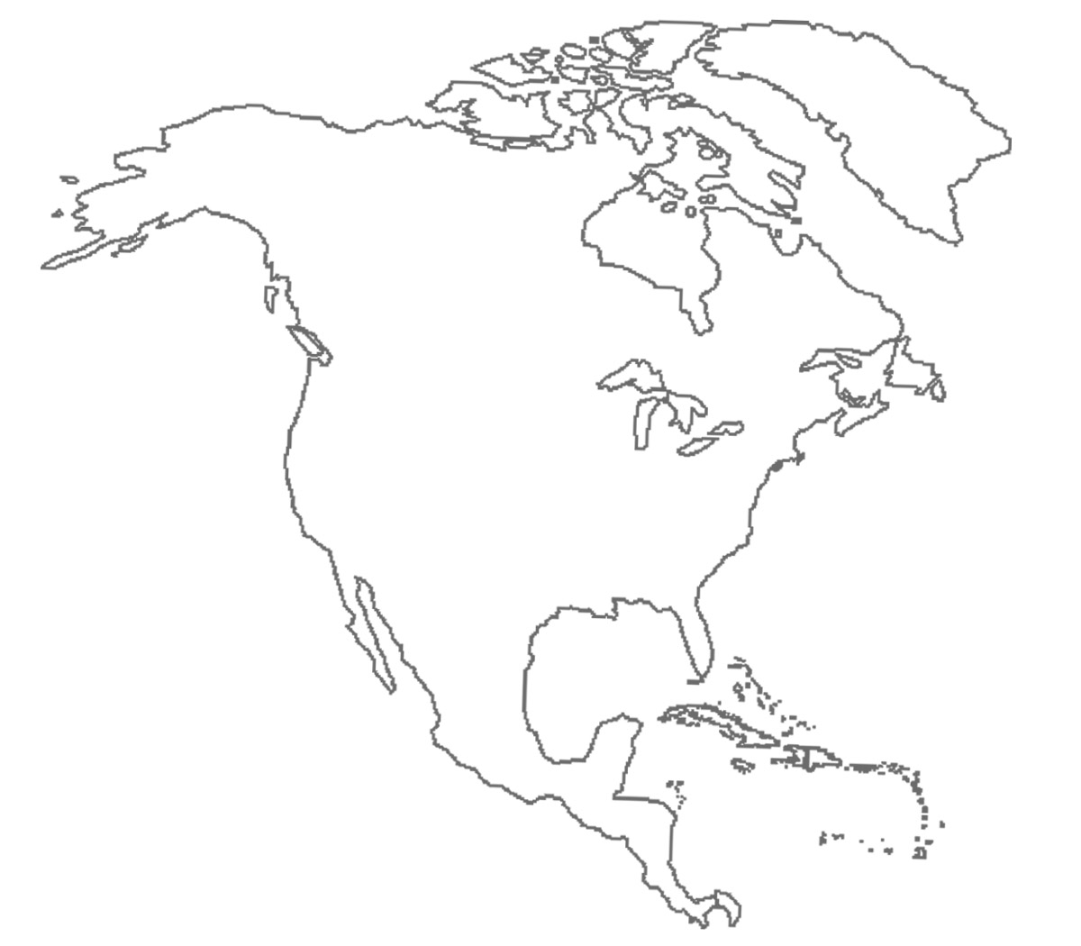
Continent of North America!
2,500 miles

Slide 9
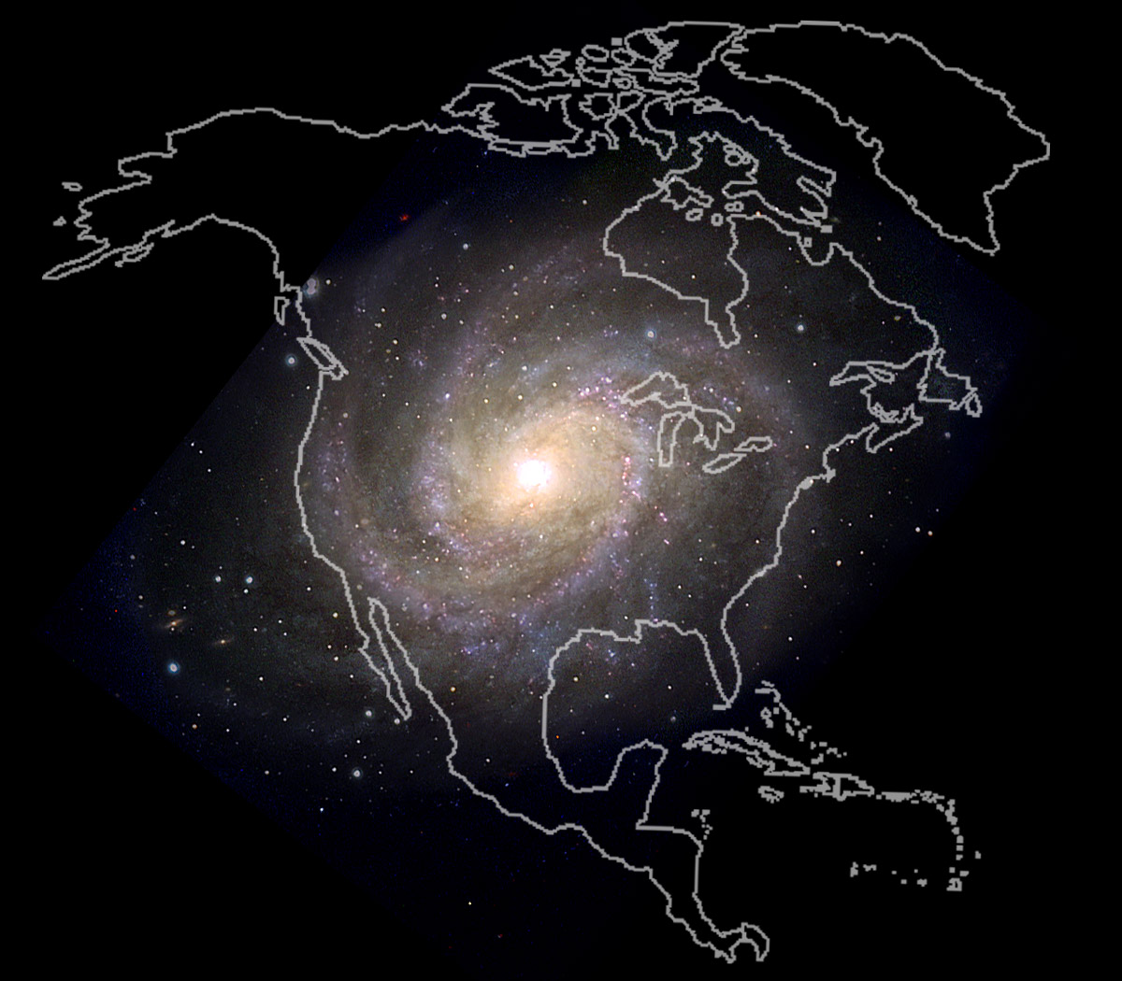

Slide 10
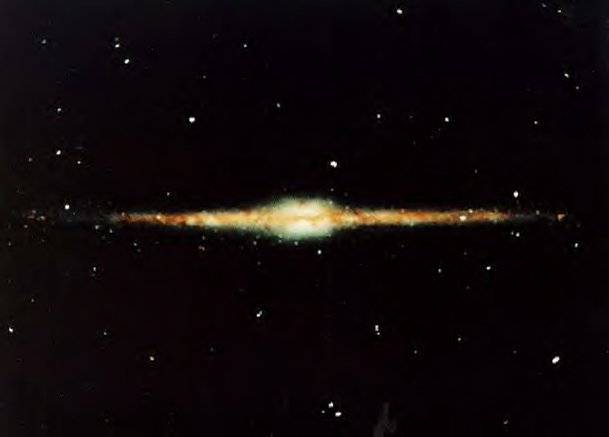
And how thick is our Galaxy?
~1000 light years
Credit: NASA, COsmic Background Explorer (COBE) Project

Slide 11

How thick is 1,000 light years?
If 2,500 miles represents 100,000 light years
25 miles represents 1,000 light years

Slide 12
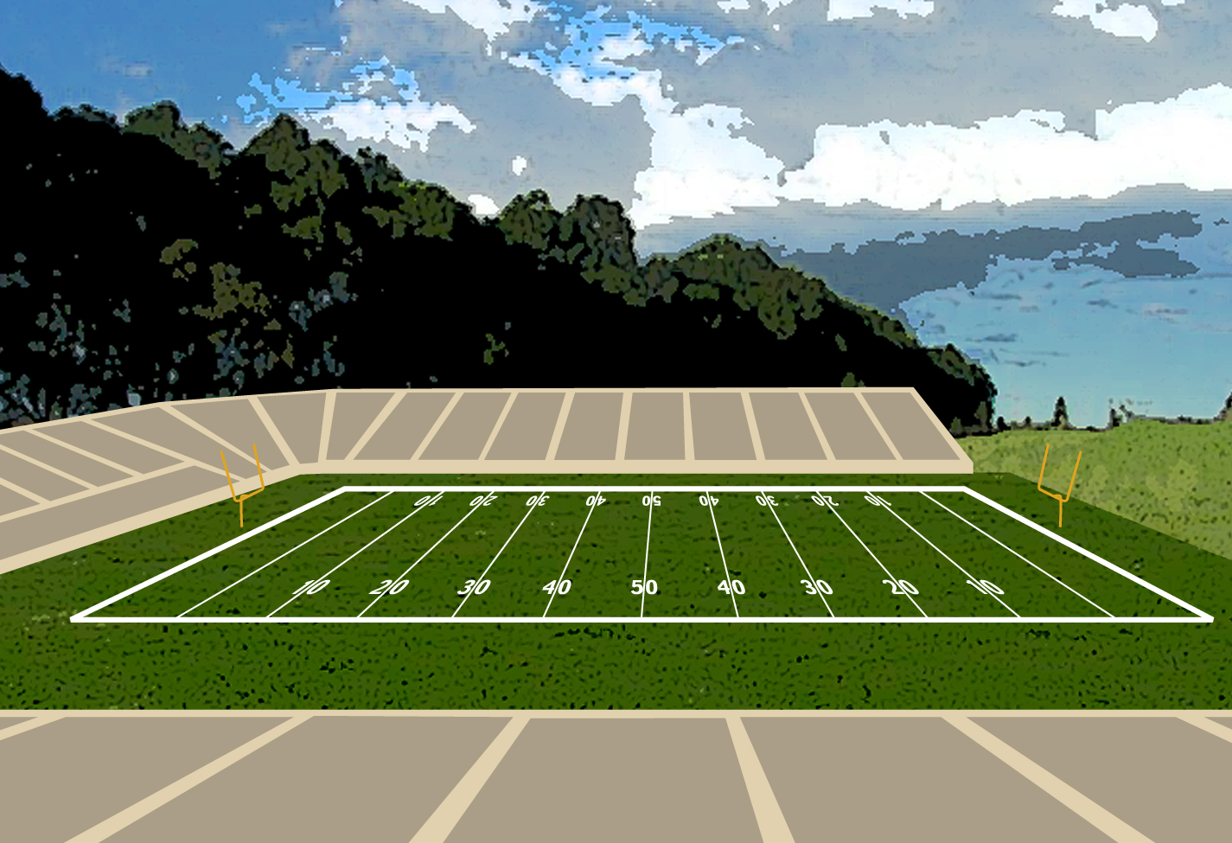
200 BILLION Stars!!!

Slide 13
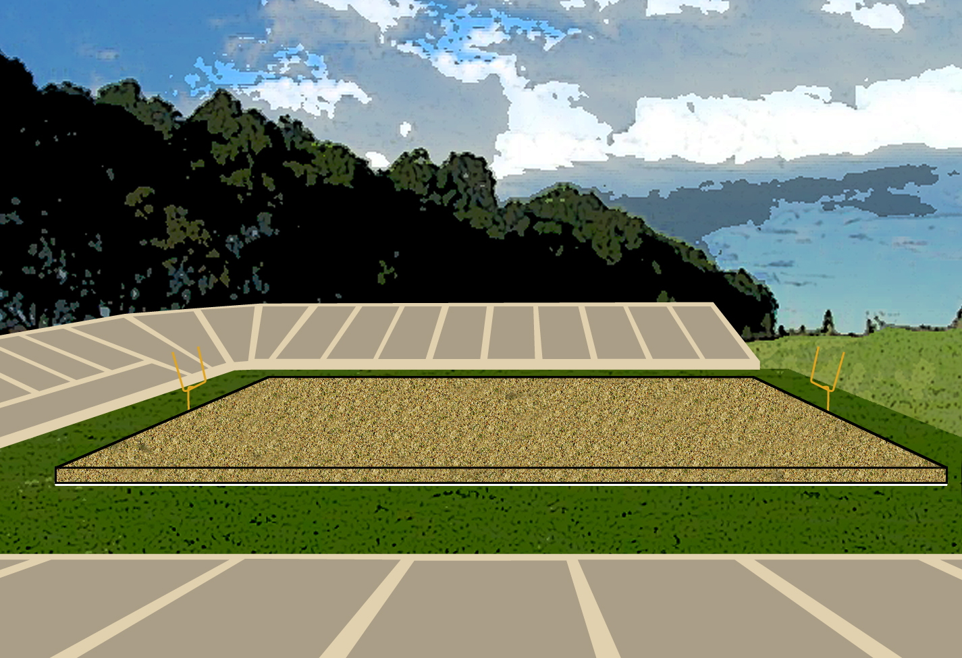
Fill with bird seed
4 feet deep on a football field
200 BILLION Stars!!!

Slide 14
Spread them over the continent
25 miles deep!
2,500 miles

Slide 15
Notes:
So … are you ready to look at all the things in our Galaxy through the telescopes?
Many of the amateur astronomers can tell you about how far away the object is that you will see, on the scale of the Solar System as a bit bigger than a quarter and the Galaxy the size of North America. For example, the North Star is 430 light years away. But on this scale where we have shrunk our Solar System down, it is about 11 miles away - or about as far away as ___( pick a city or landmark about 11 miles from your location).

