Slide 1
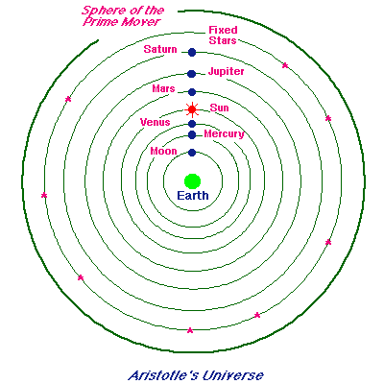
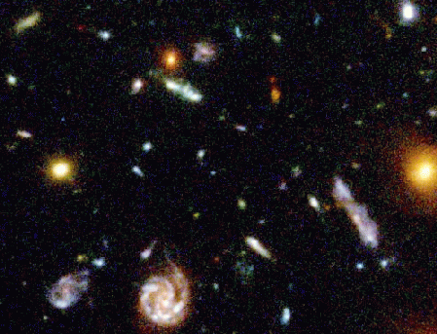
How Telescopes Changed our Understanding of the Universe
STScI and NASA
Notes:
400 years ago, before telescopes, our understanding of the universe was very different. This is what was believed:
We live on a spherical ball orbited by the rest of a finite, spherical universe.
Earth does not move.
It is the center of the universe.
Our Sun orbits the Earth, as do all the other planets and the Moon.
The stars are distant objects, always perfect and unchanging.
How did telescopes & associated technologies unlock the secrets of the universe and help us toward the understanding we have today where Earth is no longer at the center of the universe? Instead, we know that ours is a small planet orbiting a star in the suburbs of a large galaxy filled with billions of other stars and planets, surrounded by billions of other galaxies becoming increasingly ever distant from each other by the expansion of space.
This is the story of how telescopes continuously changed our understanding of the universe and our place in it - transforming our view of our universe. And we still have much more to discover!

Slide 2
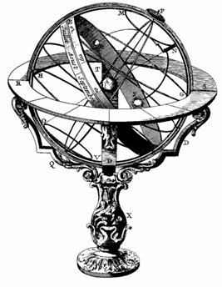
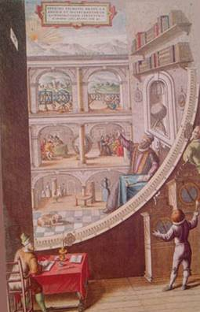
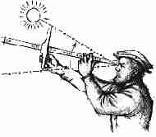
Before Telescopes
We only had our eyes . . .
and a variety of measuring instruments.
Notes:
Before telescopes, we could only use our eyes and a variety of measuring instruments to plot the positions and movements of objects in the sky to create a limited understanding of our universe.
We had no way to know what these objects actually were and little evidence for our relationship to the cosmos.
--- Images: Armillary Sphere Tycho Brahe’s quadrant Jacob’s Staff from http://members.shaw.ca/mjfinley/astronomers.html
Fascinating fact: The positional accuracy of any object in the sky before telescopes was about 1 arc minute (1/60 of a degree) – the limit of the resolution of the human eye. Yet some amazing things were discovered by pre-telescopic astronomers, such as the distance to the Moon and the relative separations of the Sun and planets, and the elliptical orbits of the planets.

Slide 3

And we had many questions…
How far are
the stars?
What are they
made of?
Is the
Solar System
at the
center of
the Galaxy?
Is Earth the
center of
the universe?
Is there more
than one
galaxy?
Did the
universe
have a
beginning?
Are there
other planets
outside of
our solar
system?
Notes:
Over the years, we had many questions about our universe. Here are some of the big questions whose answers were revealed by increasingly sophisticated telescopes and telescope technologies that helped us re-assess our place in the universe.
PRESENTATION NOTE: To shorten the presentation, you may want to allow your audience to vote on the three or four questions from this slide they would like discussed.

Slide 4
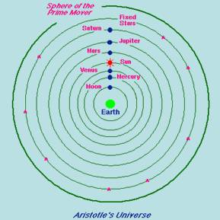
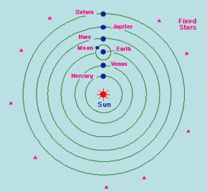
Big Question 1: Is Earth or Sun at the center?
Is Earth the
center of
the universe?
Aristotle said “Earth”
Copernicus said “Sun”
Notes:
Big Question #1 – Is the Earth or the Sun at the center?
Before telescopes, there was no evidence that the Earth orbited the Sun – and not the other way around. Prior to about 400 years ago, it was generally believed that the Earth was the center of the Universe (as in Aristotle’s model) and everything else - Sun, Moon, Planets, stars - revolved around it.
A competing theory, advanced by Copernicus in the early 1500’s, was that the Sun was at the center and the Earth orbited it. It would take a telescope to determine which one was true.
--- Additional exercise: An interesting exercise with your audience would be to take them outside and ask them (if it is daytime) what proves that the Earth, not the Sun, moves, using just evidence your eyes can see. The answer is that without sophisticated measurements, there is no evidence that indicates whether it is the Earth or Sun that moves.
Fascinating Fact: Aristarchus 310-230 BC proposed a Sun centered system based on the calculation that the Sun was the biggest object in the cosmos, but his work was ignored for 1500 years! Additional Information: Both Aristotle's and Copernicus's models shown on the slide should have epicycles. These have been eliminated here for simplicity. Aristotle (and Ptolemy) needed them mostly to account for retrograde motion, and Copernicus needed them because he insisted on making the planets' orbits exactly circular. Epicycles were then needed to explain the deviations of the planets' motions from that of circles.

Slide 5
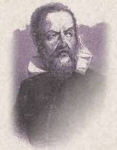

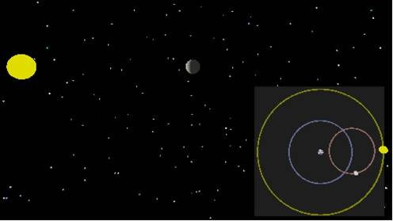

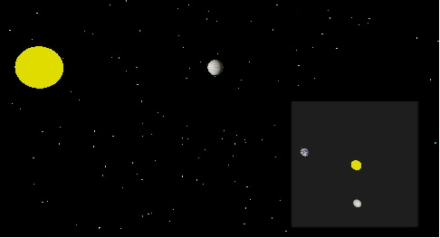
Galileo observes Venus
Earth-centered System
Venus
phases
revealed!
What Galileo observed
Sun-centered System
(Play Optional Movies)
Used with Permission. Copyright Penn State University.
Notes:
Then Galileo came along. After hearing of a new invention called a spyglass, Galileo made a small telescope with lenses and turned it to the heavens. Galileo reported evidence that the Earth was NOT the center of the known universe, but the Sun held the central position with the Earth orbiting around it.
The most compelling evidence was the phases of Venus. These two illustrations are from the perspective of Earth.
They show how the phases of Venus would look in the Earth-centered system compared to the Sun-centered system.
Note that in the Earth-centered system
(CLICK),
Venus would only look like a crescent – it would never get larger than a crescent.
In the Sun-centered system
(CLICK),
the lit part of Venus would wax and wane more like the Moon. Sometimes Venus would look like a crescent, but at times during its orbit Venus would become almost full (or gibbous).
Which one do you suppose Galileo observed?
(CLICK)
Venus phases that would be produced by a Sun-centered system. A small telescope provided compelling evidence that the Sun was the center of the Solar System, not the Earth. Our understanding of the universe was forever changed.
---
More information:
a. Note that Galileo did not invent the telescope. Credit for its invention now seems to go to Sacharias Janssen in the summer of 1608. However, Galileo’s skills at making lenses (and his insight of what to look at) turned a curiosity into a research instrument.
b. For an explanation of the Earth-centered system and the epicycle that Venus is shown on, see: http://www.opencourse.info/astronomy/introduction/05.motion_planets/ Scroll down to section 5.2 Geocentric Cosmology

Slide 6
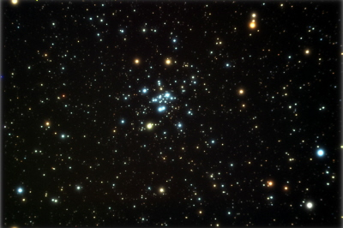
Big Question 2: How far away are the stars?
How far
away
are the
stars?
M34 image courtesy of Glenn Spielgelman
Notes:
Big Question #2 – How far away are the stars? As previously mentioned, shortly before telescopes were invented, two competing theories of the structure of the universe were debated. The long-held structure of Aristotle with the Earth at the center and the newer theory of Copernicus that the Sun was at the center. One of the arguments against the Copernicus’ notion that the Earth orbited the Sun was that we could see no change in position of the stars over the course of the year. Let’s see what that means.

Slide 7
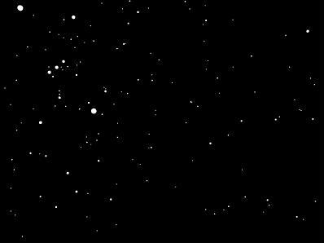
Parallax if stars were ~5000 times closer
Courtesy of David Nash, www.astronexus.com
Notes:
. This is how star positions would appear to change over six month’s time (from one side of Earth’s orbit to the other) if the stars were about 5000 times closer to us than they really are. (switch between this slide and the next to blink compare the star positions) The arrow marks one of the closest stars: Epsilon Eridani - about 10 light years away. You can tell which stars are closer and which farther by the amount they appear to move back and forth. This is called a star’s parallax. Which stars are the farthest away?

Slide 8
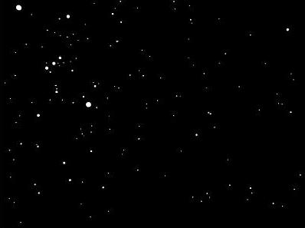
Parallax if stars were ~5000 times closer
Courtesy of David Nash, www.astronexus.com

Slide 9

Your eyes marking Earth’s Orbit
Notes:
But how far are the stars REALLY?
Pretend that the Sun is on the bridge of your nose and
(CLICK)
the Earth orbits it over your face.
Your eyes are at either side of the Earth’s orbit. Hold your finger in front of you at arm’s length. (demonstrate) Imagine a star perched on the tip of your finger. When the Earth is on this side of its orbit (point to one eye), close the other eye. Note where the tip of your finger is against the background of stars (next slide).

Slide 10
Background of stars
Courtesy of David Nash, www.astronexus.com
Notes:
Now the Earth is on the other side of its orbit (point to your other eye).
See how much the tip of your finger appeared to move against the stars?
Now let’s move you and your face, representing Earth’s orbit, to the correct distance from that star on your finger.
I now have the star on the tip of my finger (hold your finger up). You need to move about 15 miles away. Then close one eye, then the other. That’s about the amount of parallax, or apparent change in position, the star Epsilon Eridani really has. No wonder that tiny change couldn’t be seen without telescopes!

Slide 11
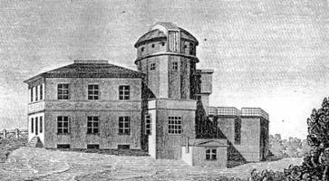
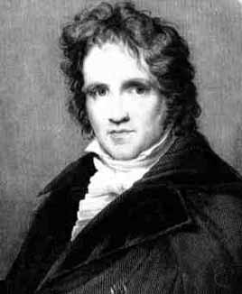
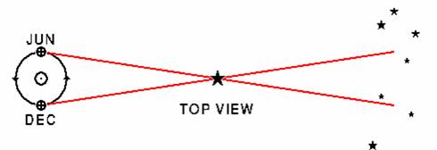
Distance to the stars revealed!
Königsberg Observatory
1838
NOW
6 Months Later
Friedrich Wilhelm Bessel
Notes:
But if parallax could be measured, a simple formula could be applied to determine the distance to the star. Many astronomers were studying the problem. While pinpointing positions of 50,000 stars using instruments at the Königsberg Observatory, Friedrich Wilhelm Bessel was the first, in 1838, to measure the parallax of a nearby star, setting an accurate distance scale for the stars. We could now know the stars are tremendously far away. The nearest visible star is 4 light years away – that’s over 20 trillion miles! In the 1800’s no one was guessing the stars were that far away.
--- The diagram at the bottom of the slide represents the Earth in orbit around the Sun, showing its position now and 6 months from now. The apparent location of the closer star changes relative to the background stars.

Slide 12
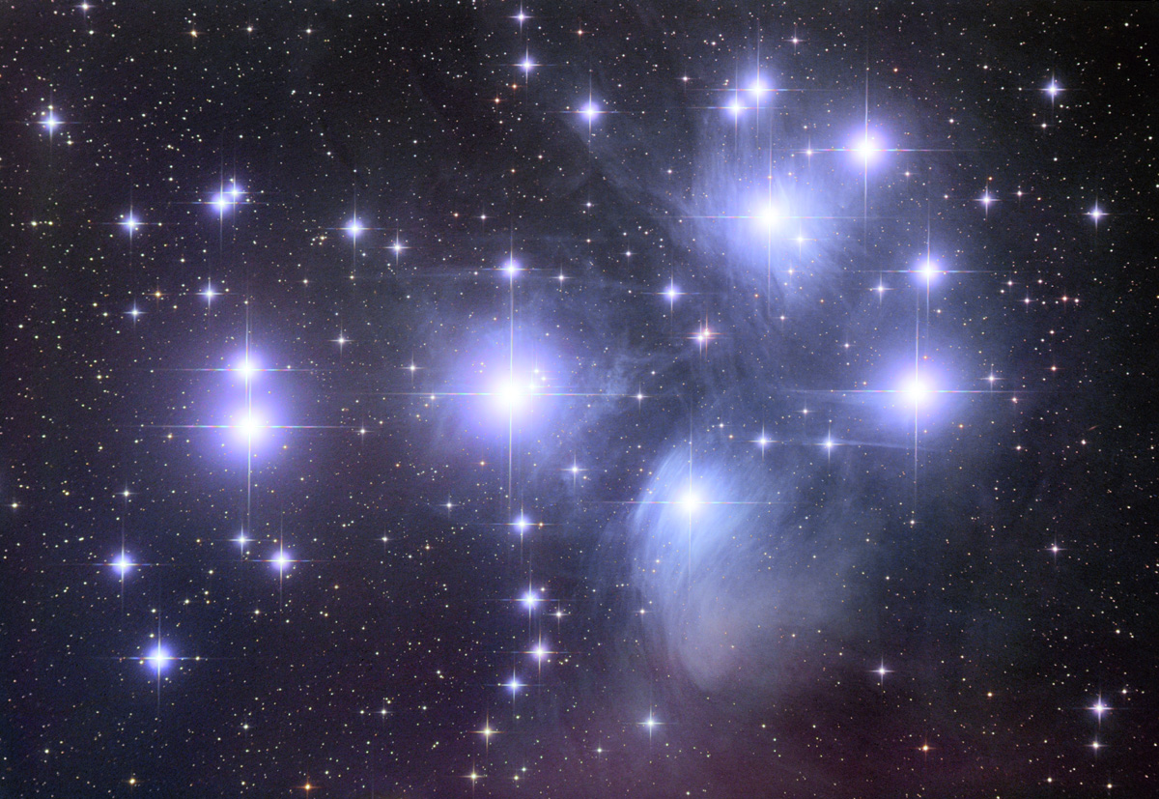
Big Question 3:
What are the stars made of?
What
are the
stars
made of?
Notes:
. Big Question #3 – What are the stars made of? In 1835 the French philosopher August Comte stated that humanity would never be able to determine the chemical composition of the stars.

Slide 13
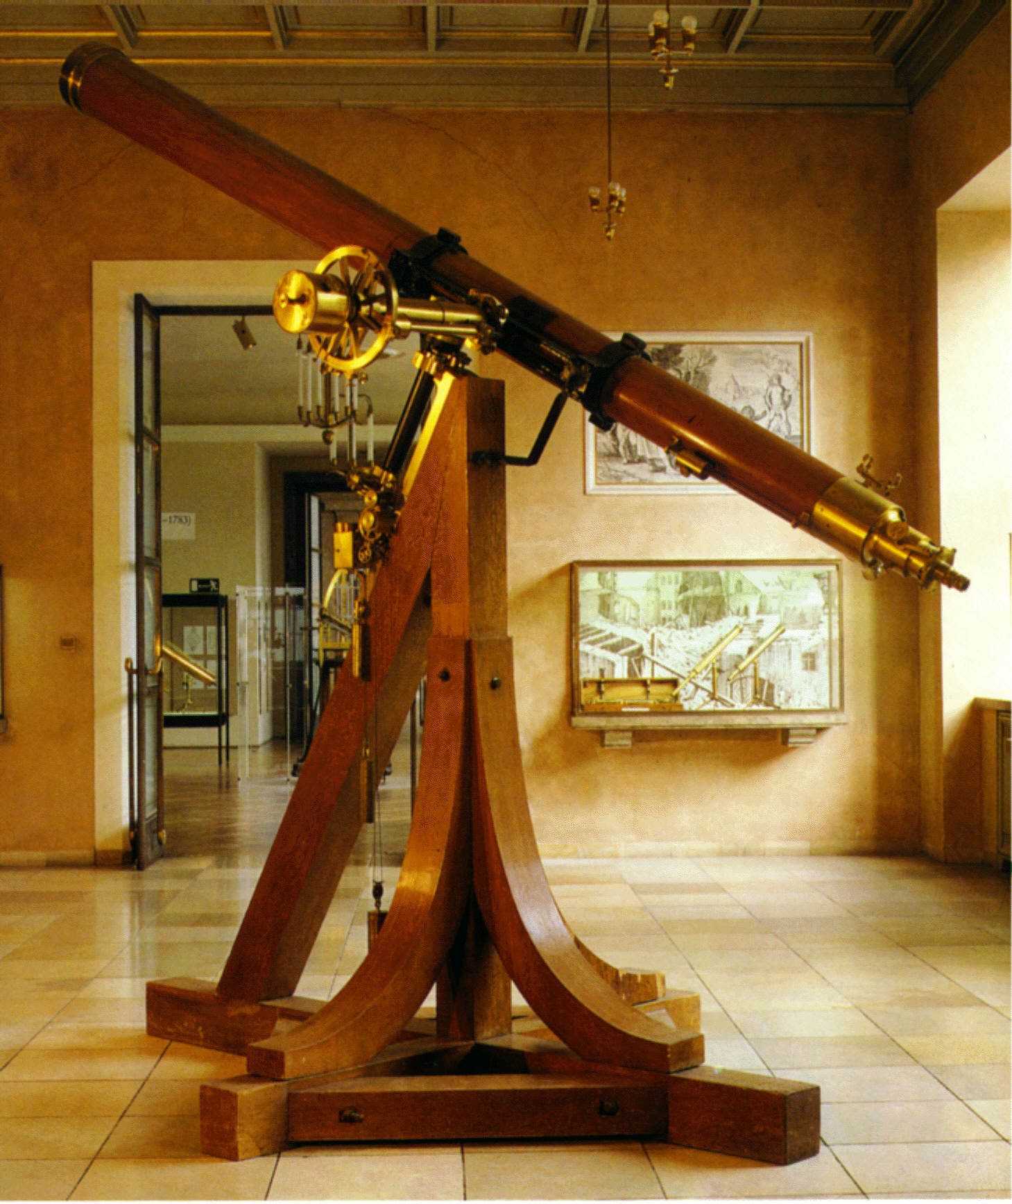
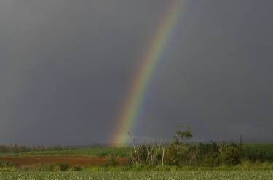
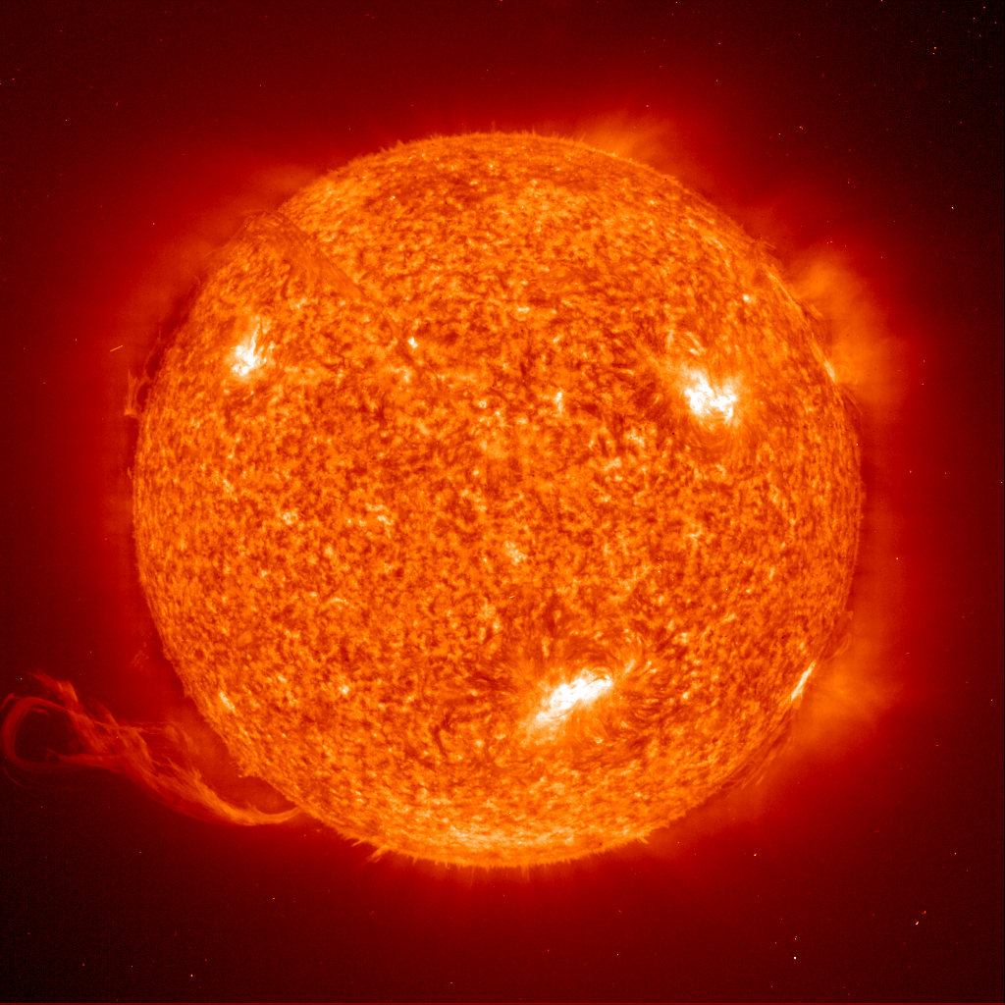
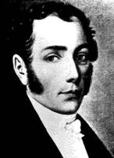
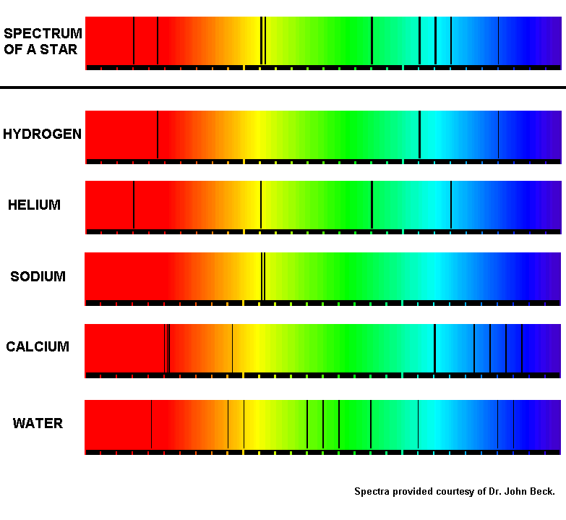
Studying the Rainbow
Konigsburg Heliometer
Sun
Fraunhofer
1814
Simulated Spectrum of the Sun
Courtesy of Dr. John Beck
Notes:
Yet the seeds of discovery had already been sewn. In 1814 Joseph Fraunhofer used an instrument at that same Konigsburg Observatory called a Heliometer to study the spectrum of the Sun. What’s a spectrum? The rainbow is the white light from the sun spread out into the colors it is made from. If we could take a section of a rainbow (CLICK) and magnify it so it was a few feet wide, we would see dark lines in the rainbow, just like Fraunhofer did. This expanded rainbow is called a spectrum. What do you suppose the dark lines mean?
--- Images:
Konigsburg Heliometer
Joseph Fraunhofer Sun (SOHO image)
Simplified solar spectrum: courtesy of Dr. John Beck.

Slide 14
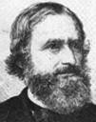
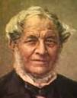
What is the Sun made of?
OF THE SUN
Kirchhoff
Bunsen
1859
Notes:
Those dark lines turned out to be the fingerprints of the elements that made up the atoms of the Sun’s atmosphere. So we could determine what it was made of. In 1859 two German chemists, Gustav Kirchhoff, and Robert Bunsen (of burner fame), discovered that the dark lines in Fraunhoffer’s spectrum matched exactly lines seen in the spectrum of gas flames in their laboratory. They discovered elements like iron, magnesium, copper, zinc, and nickel in the Solar spectrum. What other elements can you find in this simulated solar spectrum? Example: We can exactly match the 3 lines from the spectrum of Hydrogen . (CLICK) to 3 of the lines in the solar spectrum. Answers: Hydrogen, Helium, and Sodium. All but the calcium and water lines show up in the spectrum of the Sun’s atmosphere.

Slide 15
Confirmed: The Sun is a Star!
=
The stars are other Suns!
1863
Notes:
By 1863, the spectra of stars revealed these same dark lines - characteristic fingerprints of known elements. And these elements were the same kinds of elements found in the Sun. It had been supposed for many years that the stars were other Suns, but this confirmed that the Sun is a star - just one that we are very close to! The stars are other Suns!
---- Background information: William Huggins, in 1863, was one of the first to publish results of spectral analysis of stars.

Slide 16
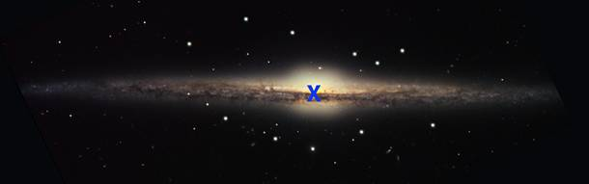
Big Question 4:
Where is the Sun in our Galaxy?
Is the
Solar System
at the
center of
the Galaxy?
?
Galaxy image credit: Hugo, Gaul, Block (KPNO Visitor Program), NOAO, AURA, NSF (modified)
Notes:
Big Question #4 – Location of the Sun in the Galaxy? Less than 100 years ago, with no evidence to the contrary, it was still widely held that the Sun, along with its planets, was at or near the center of the known universe – it was still unknown that our galaxy was just one of billions of galaxies. Most astronomers still thought, with no other evidence available, that our galaxy was the whole universe. But could the Solar System’s location in our galaxy (or the known universe!) be determined?
----- IMAGE: Simulated edge-on view of our Galaxy. This is actually NGC 4565. Image credit: Hugo, Gaul, Block (KPNO Visitor Program), NOAO, AURA, NSF. Positions of globular clusters are simulated.

Slide 17
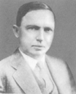
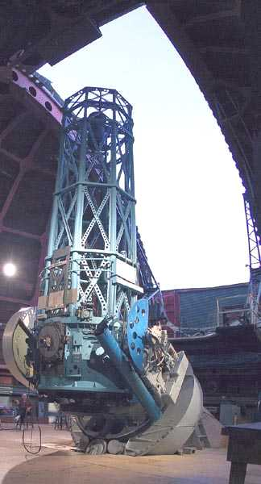
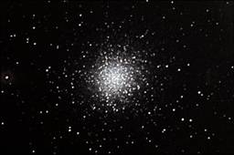
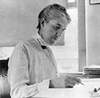
Shapley observes dense star clusters . . .
Harlow Shapley
Globular Cluster M13
Courtesy of Glenn Spiegelman
Henrietta Leavitt
Mount Wilson 60-inch Reflector Telescope (completed in 1914)
Courtesy of Gale Gant
Notes:
In 1914, the largest telescope in the world at the time had recently been constructed on Mount Wilson in southern California – a 60-inch reflector.
Harlow Shapley, originally a journalist, now turned astronomer, began observing globular clusters, compact spheres of thousands of stars, through the 60-inch.
At Harvard in 1918, Henrietta Leavitt and Harlow Shapley developed an accurate method of measuring large distances by using a particular type of star, called a Cepheid Variable.
Shapley discovered Cepheid variable stars in many of the clusters. Using this, Shapley was able to estimate the distance to the clusters.
--- Background information:
How Cepheid variables are used to measure distances: They are variable stars, with very regular periods. The length of a Cepheid’s period is directly proportional to its absolute luminosity. So based on the period, we can calculate how bright the star should be and we can see how dim it appears to be, so we can calculate how far away the star must be to appear that dim.

Slide 18
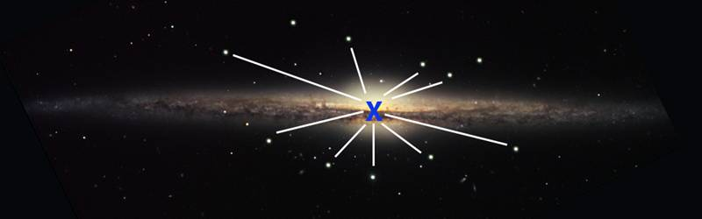
Location of the Sun in the Galaxy?
Galaxy image credit: Hugo, Gaul, Block (KPNO Visitor Program), NOAO, AURA, NSF - Globular cluster locations simulated
If the Sun and planets were at the center, globular clusters would be evenly distributed around us.
What did Shapley discover?
Notes:
If we were at the center of the galaxy, these star clusters should be randomly distributed in all directions around us. Using the distances to the star clusters, Shapley mapped the three-dimensional distribution of these star clusters. What did this mapping reveal?

Slide 19
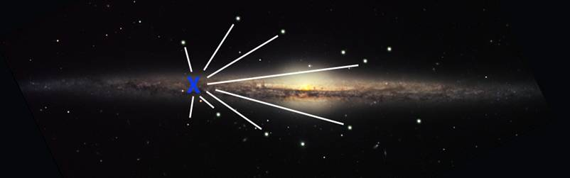
Location of the Sun in the Galaxy established!
Galaxy image credit: Hugo, Gaul, Block (KPNO Visitor Program), NOAO, AURA, NSF - Globular cluster locations simulated
Globular clusters are distributed to one side of us.
The Solar System is nearer the edge of the Galaxy!
1918
Notes:
In 1918 Shapley published a report that the clusters were found to be in a spherical distribution in one direction – toward the constellation of Sagittarius. The location of the center of our galaxy had been determined, and we weren’t there! In fact, the Solar System (the sun and its planets) was far from the center – out in the suburbs. Our place in the universe had once again changed!

Slide 20
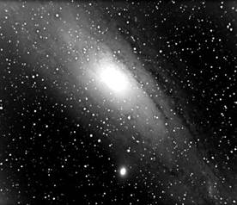
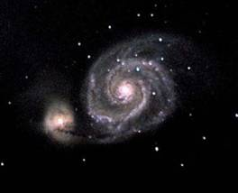
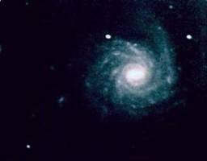
Big Question 5: One Galaxy or Many?
M51 courtesy of M. Harms
M31 - Andromeda courtesy of G. Spielgelman
Is there more
than one
galaxy?
NGC 1232 courtesy of M. Harms
Notes:
Big Question #5 – one galaxy or many? As was mentioned, less than 100 years ago it was still unknown whether our galaxy was the whole universe or just one of many galaxies. “Spiral nebulae” had been observed and studied since the early 19th century. The term “nebulae” refers to their fuzzy or gaseous appearance.
There was variety in their structure or shape that could be documented, but their size was unknown because their distance was unknown.

Slide 21
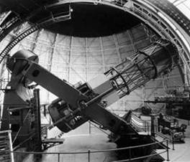
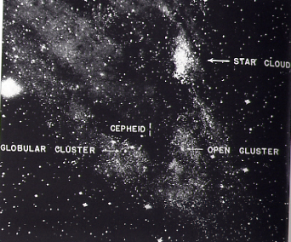
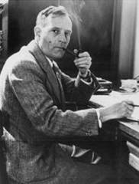
Distance to “nebulae” determined!
Mt Wilson 100-inch
One of Hubble’s photographs of the Andromeda “Nebula” with Cepheid variable marked
1924
Edwin Hubble
Notes:
In 1924, Edwin Hubble, using the newly built Mt Wilson 100-inch telescope, looked for Cepheid Variables (the same type of star used by Shapley) in the Andromeda “nebula”.
Finally, there was a telescope with the resolution and light gathering power to see individual stars in one of these “nebulae”.
By comparing how bright the stars looked in Andromeda to how bright they looked in our own Milky Way, he could estimate the distance to them, and the nebula.
The huge distance he measured (2 million light years) meant that Andromeda itself was huge, and a galaxy in its own right.
--- Images: 100” Mt. Wilson Reflector Edwin Hubble One of Hubble’s photographs of M31 with Cepheid variable marked

Slide 22
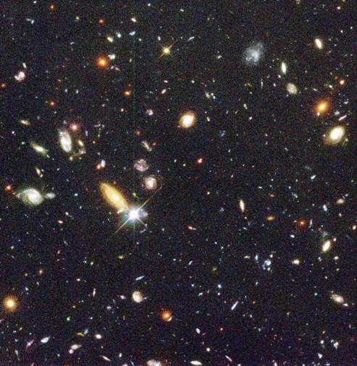
Revealing a universe full of galaxies
Credit: Robert Williams and the Hubble Deep Field Team (STScI) and NASA
Notes:
Suddenly, our Universe was not just the Milky Way galaxy, but a cosmos filled with galaxies.

Slide 23
Big Question 6:
Did the universe have a beginning?
Did the
universe
have a
beginning?
Image Credit: STScI
Edwin Hubble’s data showed that the more distant galaxies are moving away faster than the closer galaxies.
Notes:
Big Question #6 –Did the universe have a beginning?
In 1929, Edwin Hubble made another universe-shaking discovery. The universe is expanding.
He observed that the more distant galaxies are receding faster than closer galaxies.
This caused a number of scientists to hypothesize that the universe had expanded from a state of extremely high density and temperature billions of years ago and has been expanding ever since. The initial state was mostly extremely high-energy radiation which, as the universe expanded and cooled, was mostly converted to matter.
Any leftover radiation would have become stretched to lower energies as the universe expanded, looking like radiation from something with a temperature just a few degrees above absolute zero.
If this “leftover radiation” was detected, it would support the hypothesis of this “Big Bang” origin to the universe.

Slide 24
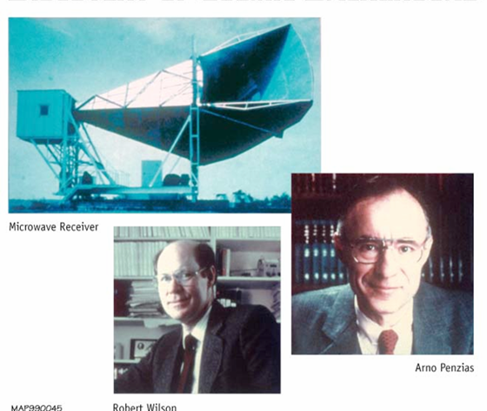

Evidence of Big Bang detected!
1965
Image courtesy of WMAP: map.gsfc.nasa.gov
Notes:
In 1965 the detection of the cosmic microwave background radiation provided this evidence.
In 1963, Arno Penzias and Robert Wilson, were studying the sky’s microwave “noise” – like radio static – for Bell Telephone Laboratories using a radio telescope.
They realized that they had detected microwaves coming from all around the sky, a universal background radiation.
Robert Dicke, a physicist nearby at Princeton University, learned of the measurement and in 1965 correctly interpreted it as radiation of about 3 degrees above absolute zero, the predicted radiation left over from the Big Bang.
(CLICK) If you tune your car radio (or another radio with an antenna) between stations, a small amount of the static or “hiss” that you hear is noise caused by the cosmic microwave background radiation.
--- Image credit: Lucent Technologies Inc.

Slide 25
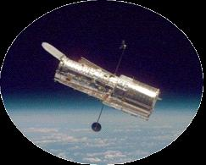
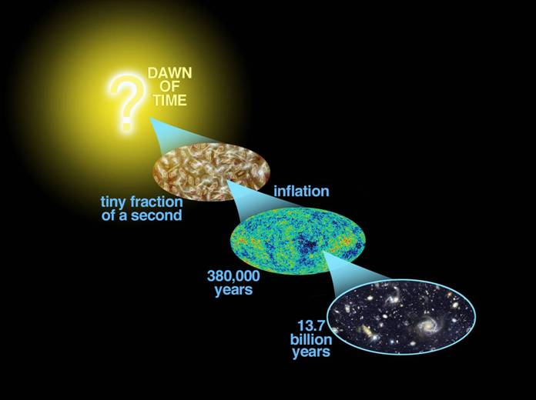
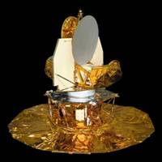
Age of the Universe calculated!
Hubble
WMAP
Notes:
Since Edwin Hubble discovered distant galaxies were receding and we discovered evidence of the Big Bang, it was suggested that we could determine how long ago the Big Bang occurred by figuring out the expansion rate of the universe and calculating back to the beginning.
Additional observations using the Hubble Space Telescope, named for Edwin Hubble, and data from the Wilkinson Microwave Anisotropy Probe (WMAP), have pinpointed the time of the Big Bang as 13.7 billion years ago, give or take 1% or 100 million years or so.
--- Images:
“Tiny fraction of a second”: artist’s image of the first moments right after the Big Bang – a hot plasma of mostly energy. “380,000 years ago”: the image of the universe as revealed by the WILKINSON MICROWAVE ANISOTROPY PROBE (WMAP) which resolved tiny, millionths of a degree, temperature fluctuations, within an extraordinarily evenly dispersed microwave light, at a frigid 2.73 degrees above absolute zero temperature. The entire sky glows with a brightness that was astonishingly uniform in every direction. WMAP can see the tiny ripples or seeds that were expected from the Big Bang, and which generated the cosmic structure seen today. 13.7 billion years – Hubble image of our universe as we view it today.

Slide 26
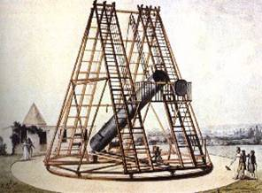
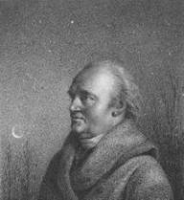
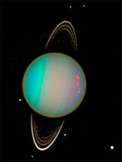
Big Question 7: Are there other planets?
In our own solar system, telescopes found planets
our eyes could not see.
Are there
other planets
outside of
our solar
system?
William Herschel
Herschel’s telescope -- used to discover Uranus in 1781
Notes:
Big Question #7 – Are there other worlds?
Within our huge Galaxy and within other galaxies, are there other worlds like those in our Solar System?
Before telescopes, we only knew of 6 planets around the Sun: Mercury, Venus, Earth, Mars, Jupiter, and Saturn.
The first “new world” ever discovered was by William Herschel who built the largest telescope of his time, a 1.2 –meter (48-inch) reflector.
The larger, more powerful telescope enabled Herschel to probe deeper into space. In 1781 he discovered a new planet – now called Uranus – that orbits the Sun far beyond Saturn. What about planets beyond the Solar System, around other stars?
---
Picture of Herschel from: www.seds.org/messier/xtra/Bios/wherschel.html

Slide 27
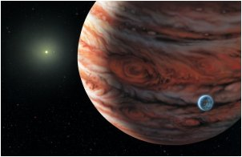
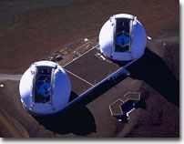
Other worlds discovered!
Artist’s concept of extrasolar planet
Artist: Lynette Cook
Courtesy of W.M. Keck Observatory
1990’s through Today
Notes:
Scientists first started finding planets around other stars in our Galaxy in the 1990s.
We have now detected many thousands! (For the latest number, see: https://exoplanets.nasa.gov/).
Many of the extrasolar planets we know of were discovered with the Keck telescope in Hawaii.
All of a sudden, our Solar System was no longer unique – potentially millions of other stars also have planetary systems and possibly life! Our understanding of our place in the universe had changed again. Once again, the Universe proved to be an even more amazing place than we’d imagined.
--- Artist’s conception: © 2002 Lynette Cook. Permission granted to NASA to display and distribute for educational purposes. Credit: NASA/Lynette Cook.

Slide 28
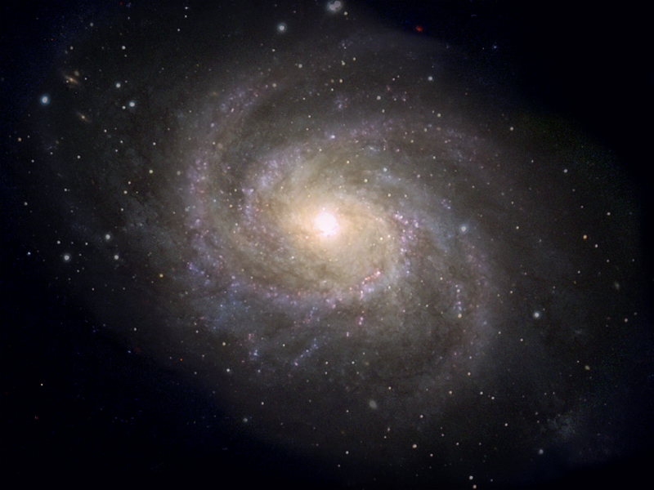
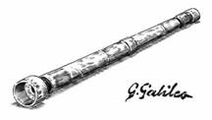

Telescopes have changed our understanding of the universe …
Notes:
So as telescopes and telescope technologies became more sophisticated, so has our understanding of the universe.

Slide 29
answering some of the big questions…
Is the Sun
at the
center of
the Galaxy?
Is Earth the
center of
the universe?
How far are
the stars?
What are they
made of?
Is there more
than one
galaxy?
Did the
Universe
have a
beginning?
Are there
other planets
outside of
our solar
system?
Notes:
Answering some of the big questions. Here are the questions we looked at.

Slide 30
answering some of the big questions…
Solar System
is about
halfway out
from the
center of
our Galaxy.
The stars are
other Suns,
VERY
far away.
The Sun is at
the center
of the
Solar System
There are
billions of
other
galaxies!
The known
universe
began
13.7 billion
years ago
There are
many other
planets
outside
our solar
system
Notes:
And the answers we’ve discovered.

Slide 31
… changing our understanding of our place in the universe!
From the center of the universe…
… to a very small planet in an immense expanding universe
Notes:
Telescopes and telescope technologies have brought us from Earth being the center of the universe to revealing that ours is a small planet orbiting a star in the suburbs of a large galaxy filled with billions of other stars and planets, surrounded by billions of other galaxies becoming increasingly ever distant from each other by the accelerating expansion of space.

Slide 32
And the more we learn, the more questions emerge!
How do
stars and
planets form?
Why are there
black holes
in the center
of galaxies?
What is
beyond Pluto
in our
Solar System?
How did
galaxies
form?
Why is
space
expanding?
Do other
planets
harbor life ?
Notes:
And we still have more to learn!
How did galaxies start forming in the first place?
Will we find evidence of life on planets outside the Solar System?

Slide 33
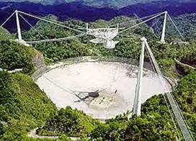




Telescopes will continue to expand our understanding of our universe.
Arecibo Image Courtesy of the NAIC
Spitzer Credit: NASA/JPL-Caltech
Chandra Illustration: CXC/NGST
GLAST Credit: General Dynamics C4 Systems
Keck Image courtesy of NASA/JPL/Caltech
Notes:
What more will we discover as we build larger and more sensitive telescopes?
There still is a Universe of possibilities.

