Slide 1
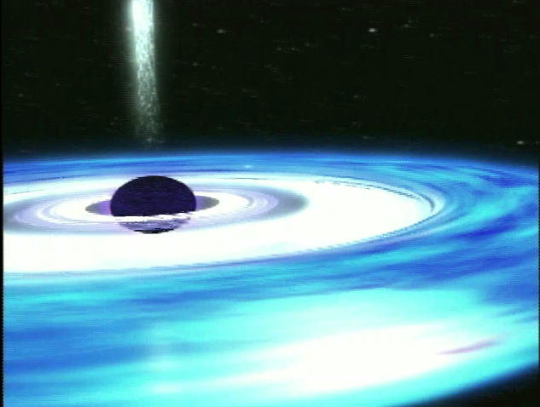
A Galaxy Full of
Black Holes
Harvard-Smithsonian Center for Astrophysics
Origins Education Forum - STScI
Navigator Public Engagement Program - JPL

Slide 2
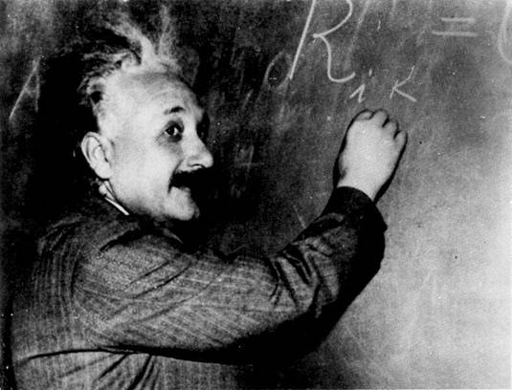
1915: Einstein’s Theory of Gravity predicted the possibility of black holes, but no one believed they actually existed!
1967: Term “Black Hole” coined
1970’s: Convincing evidence that black holes are real
Today: NASA space telescopes have discovered evidence for black holes throughout the universe
Albert Einstein

Slide 3
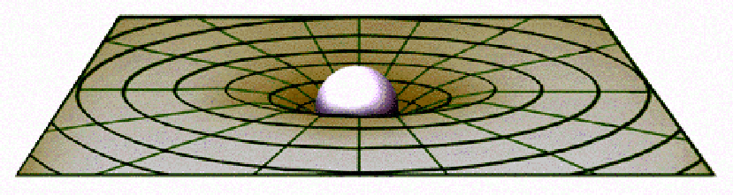

What did Einstein say about Gravity?
Mass distorts space - “curving” it
Objects and light moving near the massive object are forced to take a curved path around the object.
Just like the Moon orbiting Earth.
Images courtesy of Professor Gabor Kunstatter, University of Winnipeg
Notes:
OPTIONAL SLIDE
Images courtesy of Professor Gabor Kunstatter, University of Winnipeg

Slide 4
What is a Black Hole?
An unimaginably dense region of space where space is curved around it so completely and gravity becomes so strong that nothing, not even light, can escape.
Mass is so great in such a small volume that the velocity needed to escape is greater than the speed light travels.

Slide 5
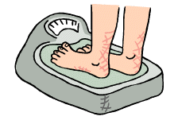
How much would you “weigh”?
On Earth, let’s say you weigh 150 lbs.
On the Moon, you’d weigh 25 lbs.
On Jupiter, you’d weigh 350 lbs.
On the Sun, you’d weigh 4,000 lbs.
Near a Black Hole,
you’d weigh over
20 TRILLON POUNDS !!!

Slide 6
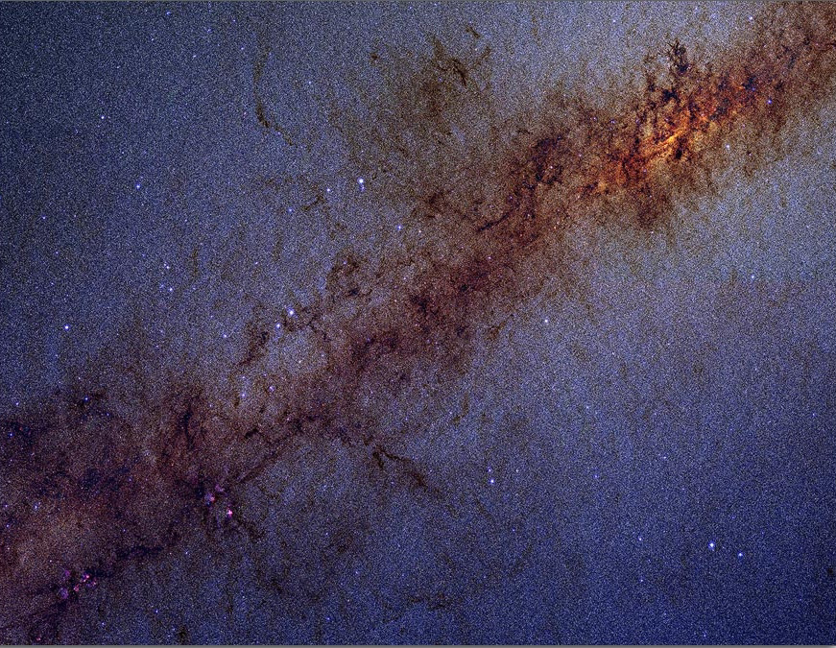
How have we survived?
There are 200 billion stars in our galaxy, the Milky Way
There are also millions of black holes
Including one giant black hole at the very center.

Slide 7

What do you think?
What happens to a spaceship that falls into a black hole?
Will the black holes in our Galaxy eventually suck up everything in it - a cosmic vacuum cleaner?
What would happen to Earth if the Sun was replaced by a black hole of the same mass?
If we can’t see black holes, how do we know they are there?

Slide 8
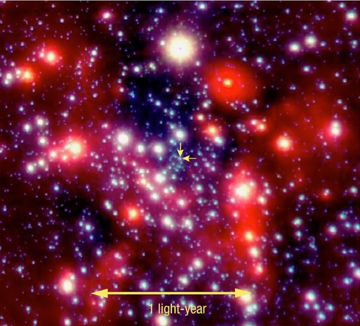
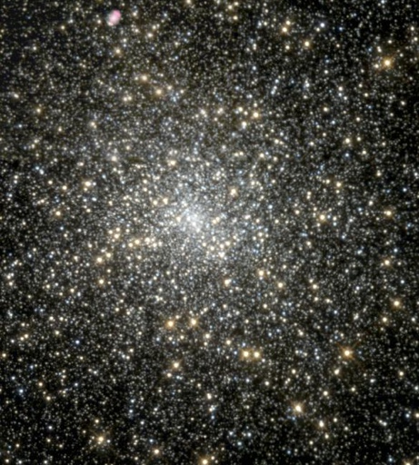
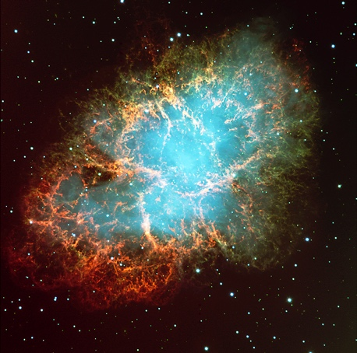
Where do black holes come from?
Three classifications of black holes:
Stellar-mass: 3 to 20 times the mass of our Sun
Supermassive: Black holes with millions to billions of times the mass of our Sun
Mid-mass: In between stellar-mass and supermassive

Slide 9

Where do black holes come from?
Stellar-mass:
Black holes are made when a giant star, many times the mass of our Sun, dies.
Most of the star’s atmosphere is blown into space as a supernova explosion.
The star’s spent core collapses under its own weight.
If the remaining mass is more than the mass of 3 Suns, it will collapse into a black hole.
Credit: European Southern Observatory
Notes:
(Credit: European Southern Observatory)

Slide 10
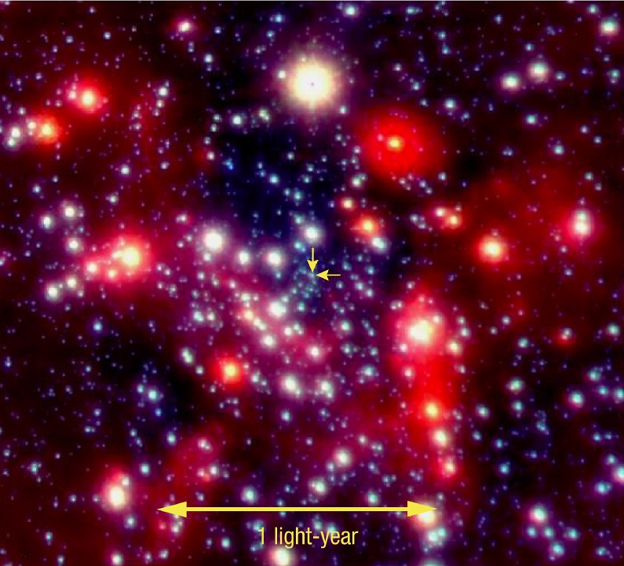
Where do black holes come from?
Supermassive:
Extremely massive black holes have been found in the centers of many galaxies - including our own!
Credit: European Southern Observatory (ESO) - Very Large Telescope

Slide 11
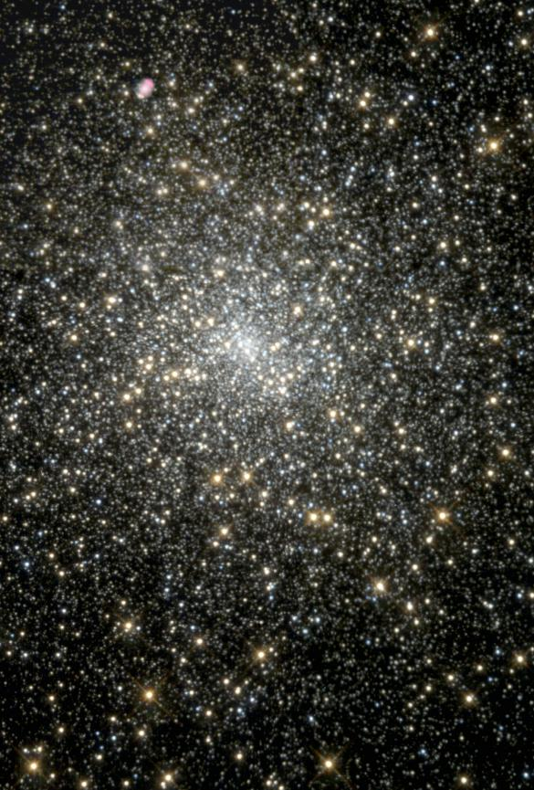
Where do black holes come from?
Mid-Mass:
Scientists are finding these in the centers of large, dense star clusters.
Like this globular star cluster, called M15, in our Galaxy.
Image Credit: NASA and The Hubble Heritage Team (STScI/AURA)

Slide 12
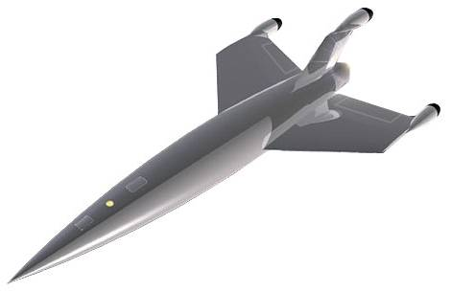
Falling into a Black Hole
Not to Scale

Slide 13
Falling into a Black Hole
Not to Scale

Slide 14
Falling into a Black Hole
Not to Scale

Slide 15
Falling into a Black Hole
Not to Scale

Slide 16
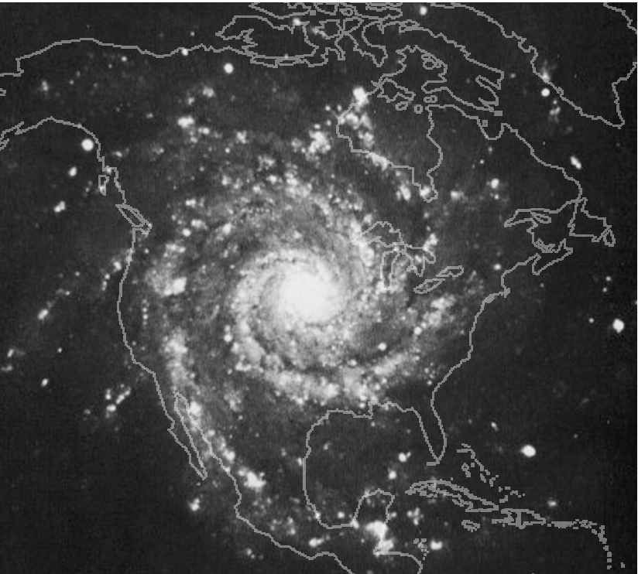
So how do we survive amid all these Black Holes?
M74 Photo Credit: NOAO/AURA/NSF
Great distances between the stars!
Notes:
Credit: M74 Photo Credit: NOAO/AURA/NSF

Slide 17
So how do we survive amid all these Black Holes?
Sun’s orbit >
M74 Photo Credit: NOAO/AURA/NSF
Everything is orbiting fast enough!

Slide 18
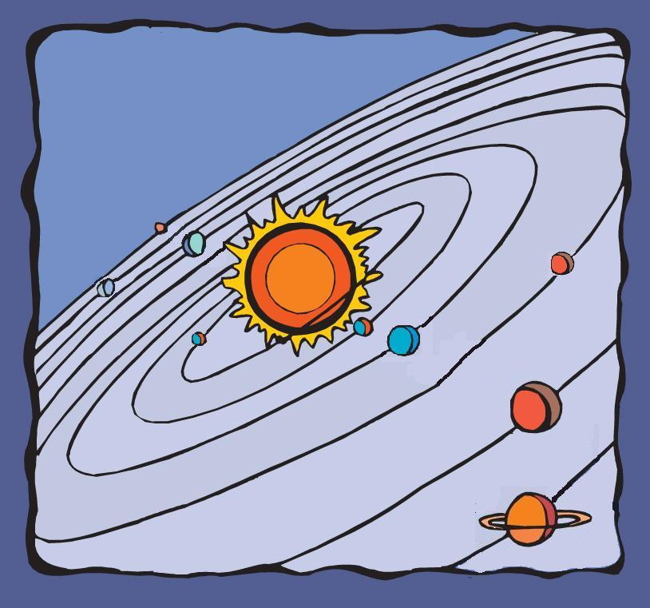
What would happen if the Sun was…
Not to Scale

Slide 19
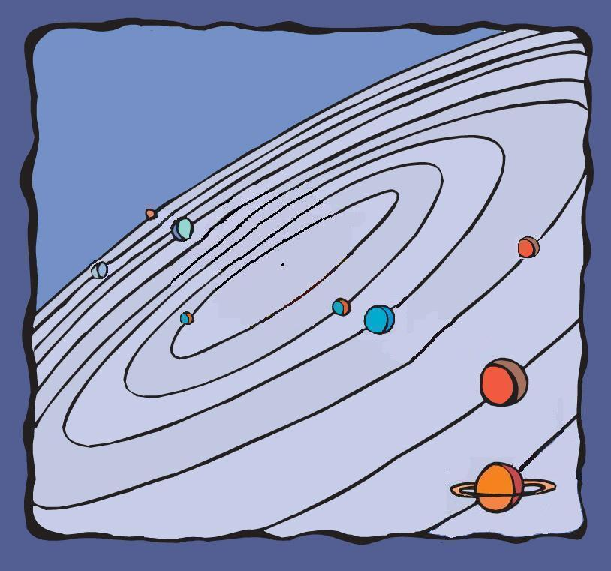
… changed into a Black Hole?
Not to Scale

Slide 20
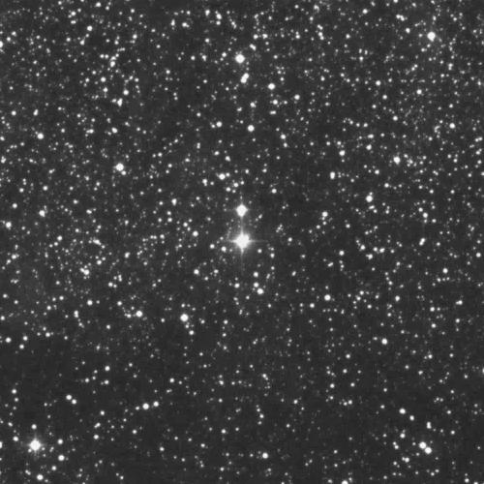
Where is the Black Hole?

Slide 21
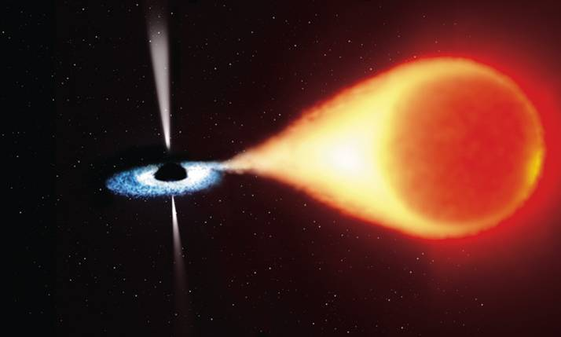
How do we know it’s there?
Jets of glowing gas
“Weird” motions of objects nearby
Hot material falling into the black hole.
Credit: ESA, NASA, and Felix Mirabel
Notes:
(An artist’s impression of an X-Ray binary system, the best way to detect a black hole. )
ANIMATION: http://nova.scitec.kobe-u.ac.jp/~matsuda/mpeg/accretion.mpg

Slide 22
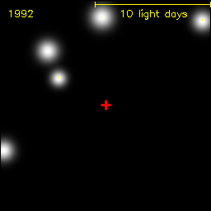
How do we know it’s there?
Years
“Weird” motions of objects nearby
Movie courtesy Max-Planck-Institute for extraterrestrial Physics, Germany.
Notes:
© Infrared and Submillimeter Astronomy Group at MPE
(Max-Planck-Institut für extraterrestrische Physik)

Slide 23
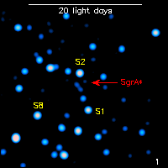
How do we know it’s there?
Hot material falling into the black hole.
Minutes
Movie courtesy Max-Planck-Institute for extraterrestrial Physics, Germany.
Notes:
© Infrared and Submillimeter Astronomy Group at MPE
(Max-Planck-Institut für extraterrestrische Physik)
NOTE: This is an infrared image rather than an X-Ray image, but the effect would be essentially the same.

Slide 24
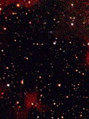

How do we know it’s there?
Jets of glowing gas
One month
Movie courtesy of R. Spencer, S. Garrington, D. McKay, T. Muxlow, P. Thomasson, C. de la Force, A. M. Stirling (University of Manchester, Jodrell Bank); G. Pooley (University of Cambridge); R. Fender (University of Amsterdam)

Slide 25
Now what do you think?
What happens to a spaceship that falls into a black hole?
Will the black holes in our Galaxy eventually suck up everything in it - a cosmic vacuum cleaner?
What would happen to Earth if the Sun was replaced by a black hole of the same mass?
If we can’t see black holes, how do we know they are there?

Slide 26
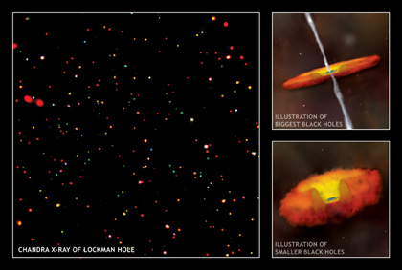
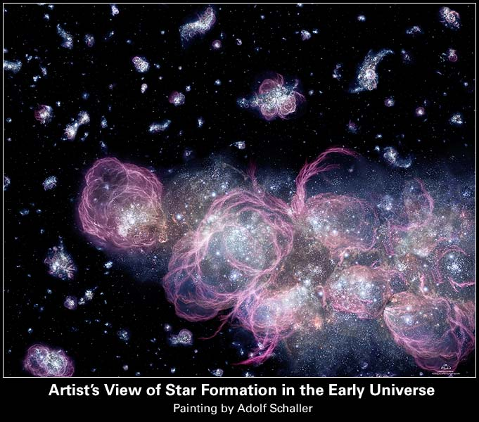
What are we trying to learn?
X-ray: NASA/CXC/U. Wisconsin/A.Barger et al.; Illustrations: NASA/CXC/M.Weiss
NASA missions continue to search for and study black holes to determine the fate of matter as it falls into black holes, how powerful jets form, and what role black holes played in the formation of the early universe.
Credit: NASA, ESA, and A. Schaller (for STScI)

Slide 27
